Slide 1

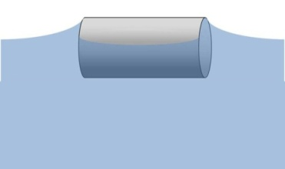
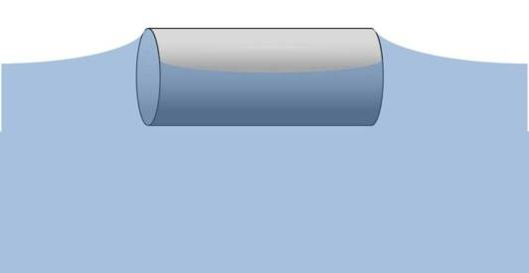
Capillary Interactions between
Anisotropic Particles
Kathleen J Stebe
Chemical and Biomolecular Engineering
University of Pennsylvania

Slide 2
Acknowledgements
Eric Lewandowski-experiment, analysis
Marcello Cavallaro-curvature gradients, confinement
Lorenzo Botto-simulation, analysis
Valeria Garbin-(Crocker)-interferometry
Lu Yao-crowded surfaces, registry, repulsion
Jorge Bernate-surface evolver
Alice Tseng- environmental SEM
MRSEC facilities at JHU/PENN; NSF

Slide 3
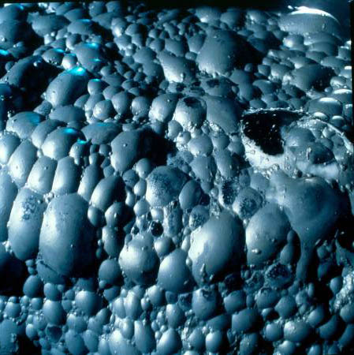
On the attraction of floating particles
W. A. Gifford and L. E. Scriven
Chem. Eng. Sci. 1971, 26, 287.
Received 8 August 1970; accepted 17 August 1970.
Capillary attraction between floating particles, a phenomenon of everyday experience as well as technological importance, is caused by interfacial tension and buoyancy forces ...
Finite Bo:
sphere or infinite cylinder
Nicolson Proc Camb Phil Soc 45 (1949)
Gifford and Scriven Chem. Eng. Sci., 26, 287 (1971)
Chan et al J. Colloid Interface Sci. 79 (1981)
Singh and Joseph Journal Fluid Mech. 530 (2005) sphere or disk
Slope Area

Slide 4
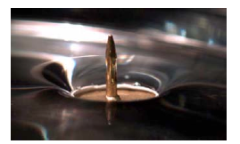
Finite weight particles
Small slope; superposn
Particles move in potential energy gradient created by their neighbor (or by a boundary)
Like beads on a strong- slide to low potential energy site
Nicolson 1949; Chan et al 1981
Bubbles, cheerios, froth flotation, ..

Slide 5
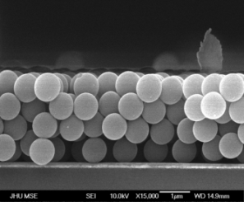
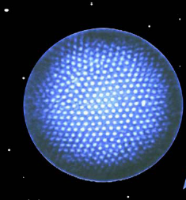
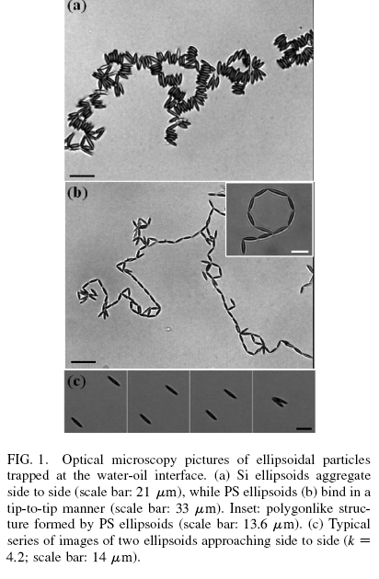
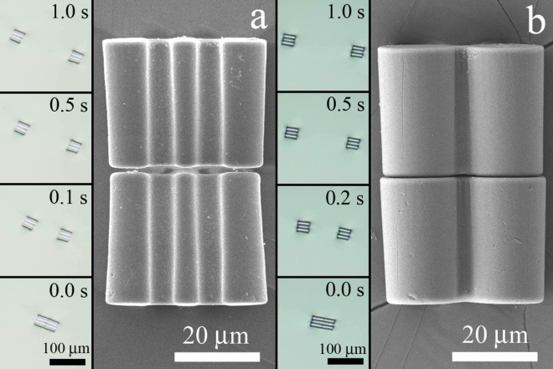
Particles at free-surfaces
Particle-stabilized emulsions
Ramsden (1904); Pickering (1907)
Bubbles
Nicolson Proc Camb Phil Soc 45 (1949)
Current interest using microparticles:
BINKS Special edition PCCP 2008
Froth flotation
Gifford and L. E. Scriven (1971)
Chan et al (1981)
Singh and Joseph (2005)
Capillary interactions-thin films
Kralchevsky, Nagayama and collaborators 1990s-
Wasan: argues not formed by capillary attraction
nuclei
Whitten, Deegan, Dupont: coffee rings...
Negligible Bond number- capillary interactions
Lucassen, Colloids and Surfaces 1992
Stamou et al: long range qp deflections Phys. Rev. E 2000
Dietrich, Oettel, and collaborators-ellipsoids
Kralchevsky and collaborators-weakly non-spherical shapes
Binks and collaborators
Cheerios effect
Ellipsoids
Hilgenfeldt Europhys.Lett. 72, 671 (2005)
Loudet* et al. Phys. Rev. Lett. 2005, 2006, 2009
Lehle et al Eur Phys Lett 2008
Vermant, Fuller, Furst-assembly and rheology
Complex shapes
Whitesides: Bowden et al. Functionalized mm-particles
Science 1997, Langmuir 2001+~20 more
  Rennie (2000); Fournier (2002): bi-metal microparticles-
  form qp
Lewandowski et al Langmuir 2008, Soft Matter 2009

Slide 6
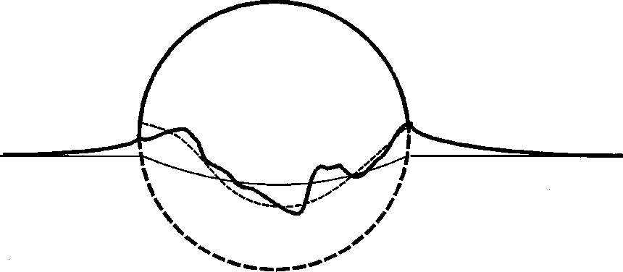
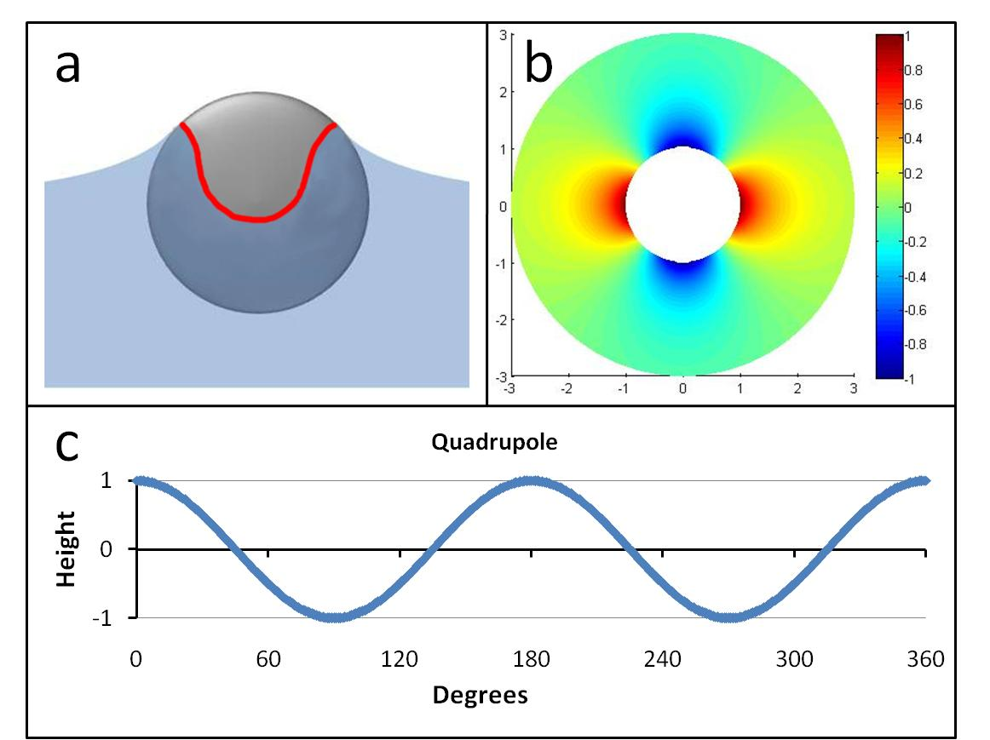
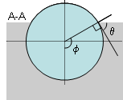
Interfacial deflections created by particle
Stamou, PRE 62, 2000
Quadrupolar deflection: long range perturbation
Stamou, Duschl, Johannsmann, PRE 2000
Kralchevsky et al Langmuir 2001

Slide 7
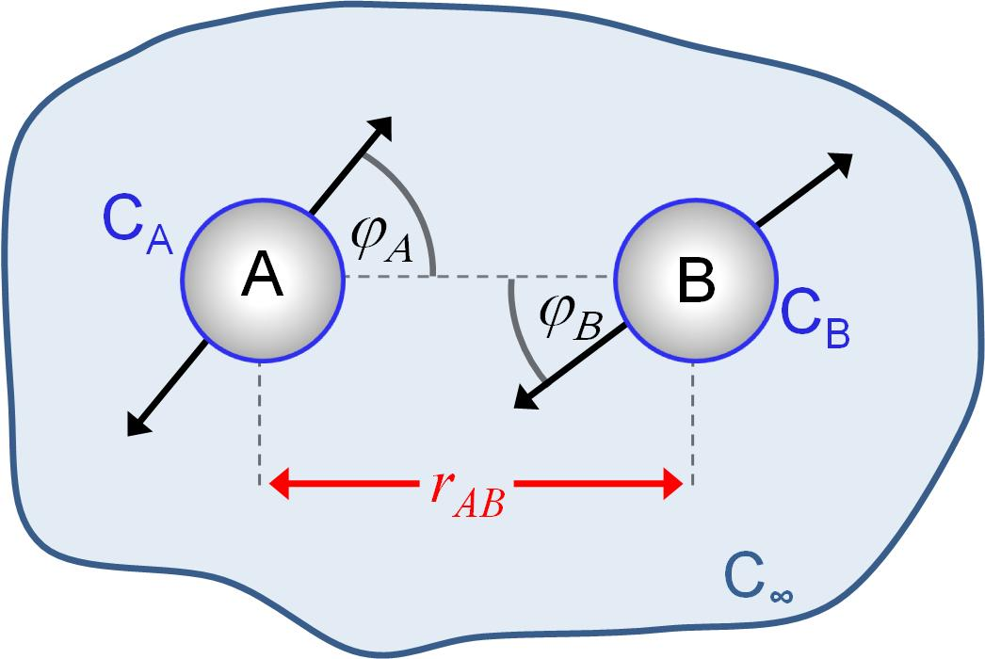
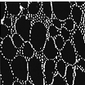
Far field interactions
Stamou, PRE 62, 2000
r₁₂
Superposition approx.
Stamou
Interaction Energy
Force of Attraction
Excess area drives interactions
but no preferred orientation
Notes:
The interface deflections created by these undulated contact lines…
Capillary interactions strong microscale and potential important at far smaller scales.

Slide 8
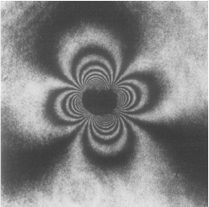
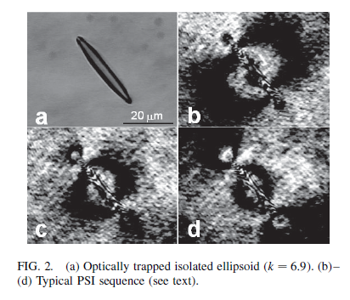
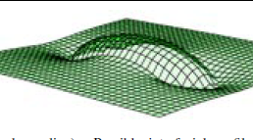
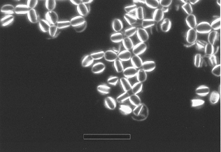
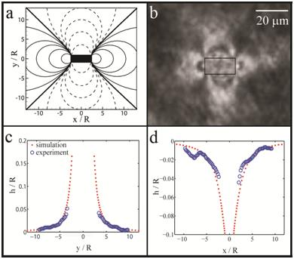
Undulated contact lines: pronounced for non-spherical particles
interferograms
Micro-Ellipsoids: Loudet
and Yodh . 2005, 2006
Floating poppy seed ~1mm
(Hinsch, 82)
Rennie: curved particles
Micro-Cylinders: Stebe lab

Slide 9
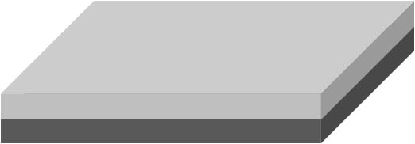
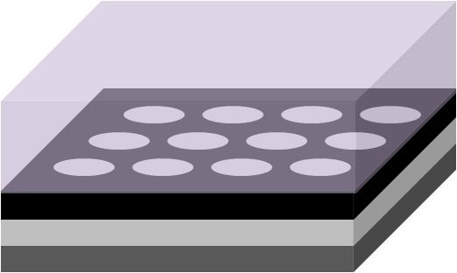
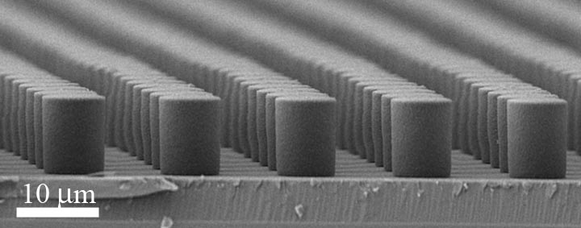
Lithographic Fabrication of Particles
SU-8 photoresist
Silicon Wafer
UV light
Mask
Expose resist through mask
SU-8 photoresist
Silicon Wafer
Develop photoresist
SU-8 Particles
Silicon Wafer
Sonicate in EtOH to free particles
Notes:
negative

Slide 10
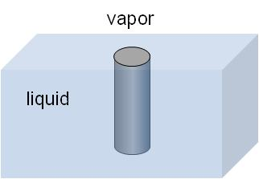
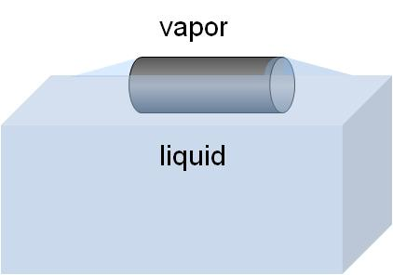
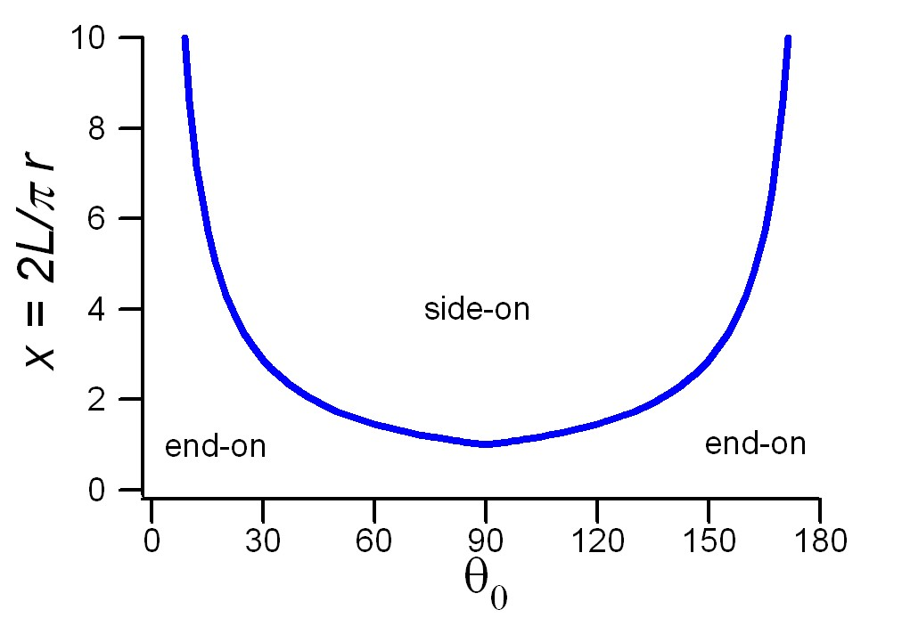
Cylinders at fluid interfaces:
Two mechanically stable states
End On
Side On
negligible
Preferred orientation: GCP
Compare Σγ_{i}A_{i} for each state

Slide 11
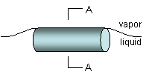
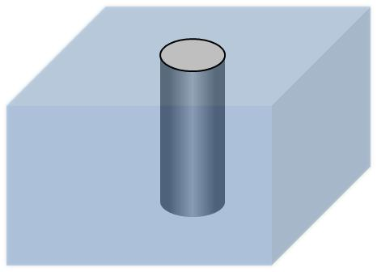
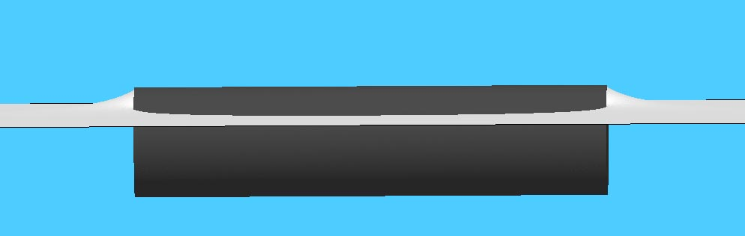
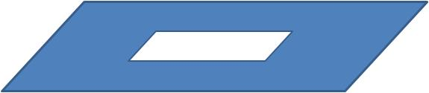
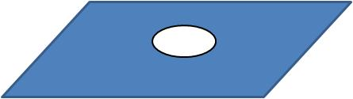
Orientation of partially wet cylinders
Side On
End On
Analytical
assume
  -Flat interface along cylindrical body
  -Ends fully wet or de-wet
  - Neglect excess L/V area
Minimum surface energy
- Surface Evolver, contact angle
L/V interface approximation
- Equate holes in interface
Neglect Gravity
Notes:
Zeta potential on or less than 25mV

Slide 12
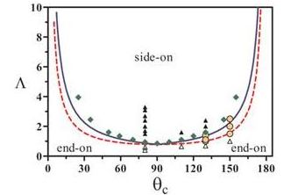

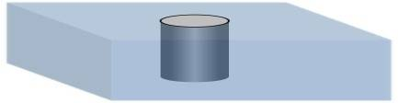
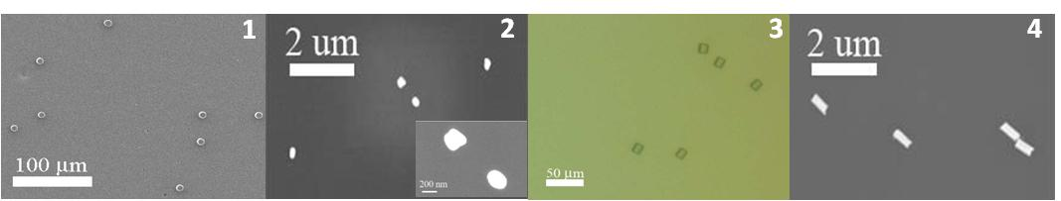
Phase diagram
Lewandowski, et al JPC B 2006; Langmuir in press
x=1.2, θ=80º,r=3.5μm
x=0.2, θ=110º,r=150nm
x=1.3, θ=80º, r=3.5μm
x=2.8, θ=110º,r=150nm
Notes:
Error between hole in interface and full solution: surface energy contributions of solid-fluid interface; undulations of fluid interface
Yellow circles indicate particles for which both the side-on and end-on configurations are observed- particles adsorbing to hexadecane-water interface (130 degree contact angle) and decane-water interface (150 degree contact angle)

Slide 13
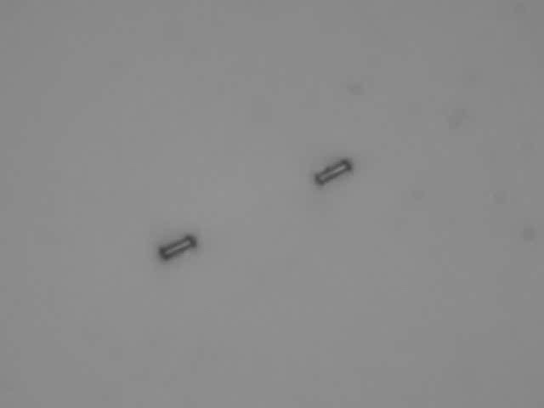
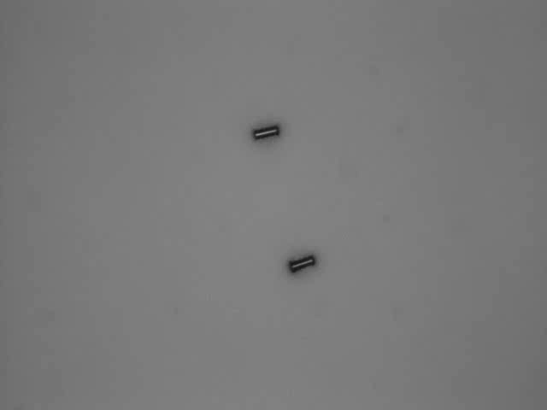
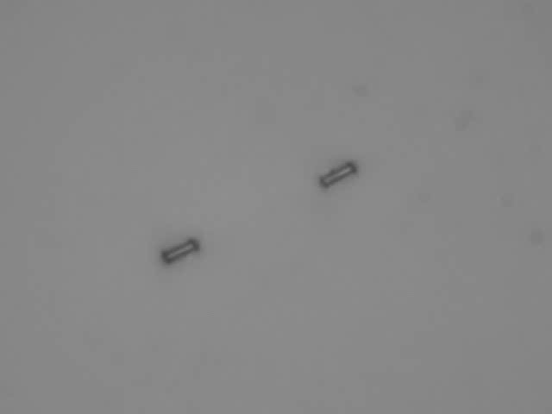

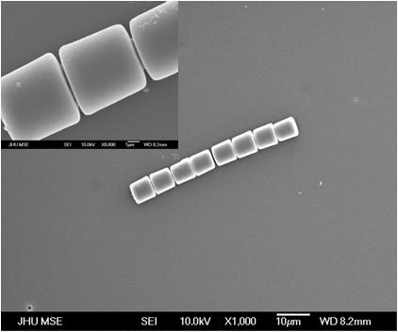
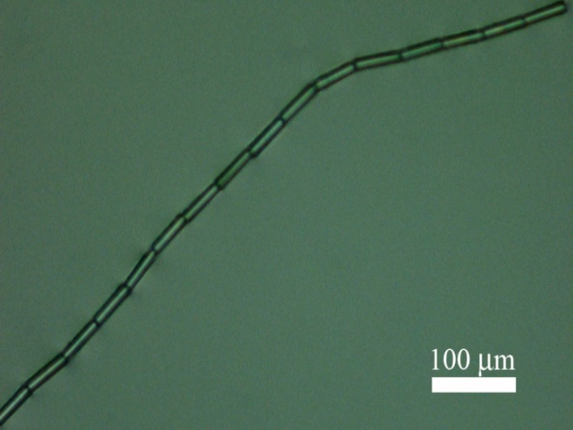
End-to-end chaining of cylinders
Undulated contact line owing to particle shape
L/D ~ 2.5
50μm
Lewandowski et al, Soft Matter, 5, 2009
Notes:
7:~30, 7:~10, 7:~4
Scale shows deflections in increments of 10⁻² of the cylinder radius
Angular approach is minimum energy for fixed r₁₂ for elliptical quadrupole

Slide 14
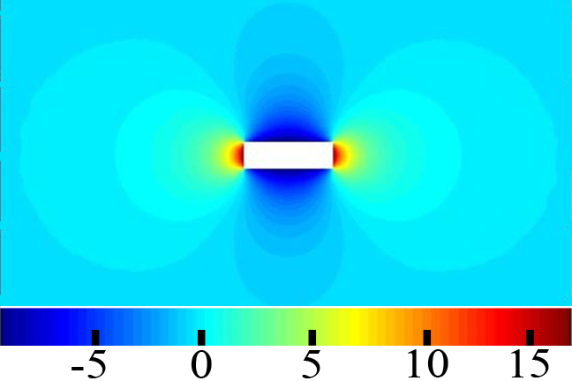
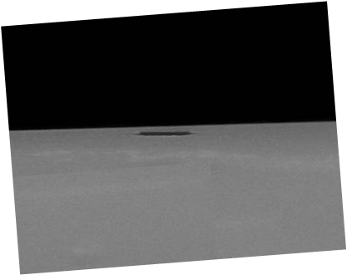
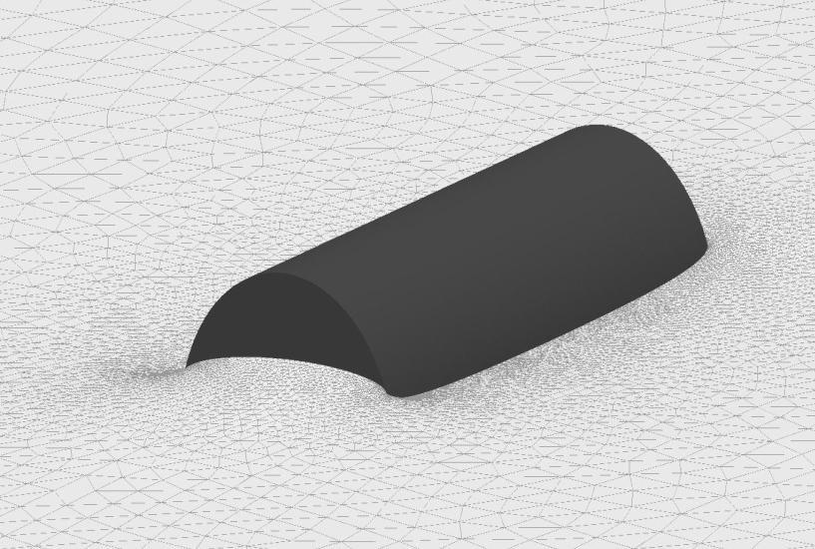
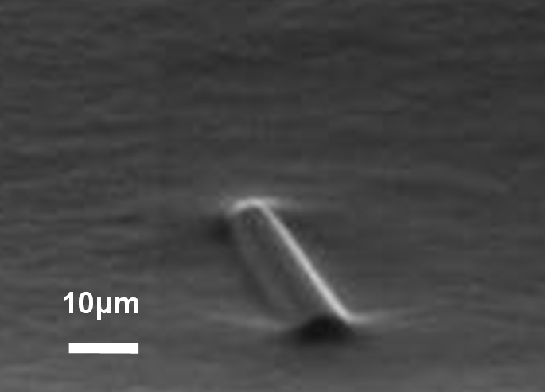
Shape of interface around isolated cylinder
θ=80º
Interface topology satisfying contact angle not unique Surface evolver simulation, const P, Neumann conditions far field
Environmental SEM
Minimum surface energy configuration
Notes:
Surface minimizing the interfacial energy subject to boundary constraints under constant pressure conditions. The simulations with the cylinder in the side-on carried out for a fixed particle with a homogeneous Neumann condition imposed at the outer boundary of the computational domain (zero slope). This boundary condition enforces a planar interface far from the particle. The condition of mechanical equilibrium for the particle, at convergence, is automatically satisfied since the far field surface is free to move in the direction normal to the interface. (This is equivalent to allowing the height of the particle’s center of mass to vary freely).

Slide 15
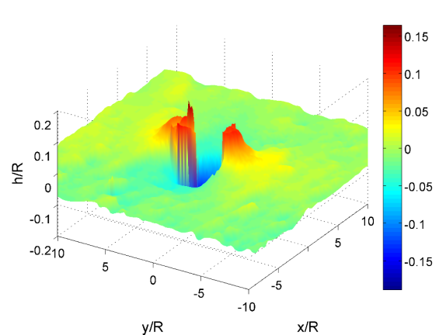
Interferometric Measurement of Interface:
V. Garbin, J. Crocker, interferometry
Notes:
Reflection interference contrast microscopy (RCIM) is used to measure the interfacial topology around the particle. The beam from a diode-pumped solid state laser (λ = 532 nm) is collimated by the microscope objective onto the particle-laden aqueous air interface. Light reflected off the interface interferes with light reflected off the glass bottom of the dish (Fluorodish). The resulting interferograms are recorded on the camera sensor through the same objective. Through standard phase shifting techniques, the three-dimensional interface shape is reconstructed. The height profile is obtained with a resolution better than 50 nm, and the lateral resolution is about 500 nm.

Slide 16
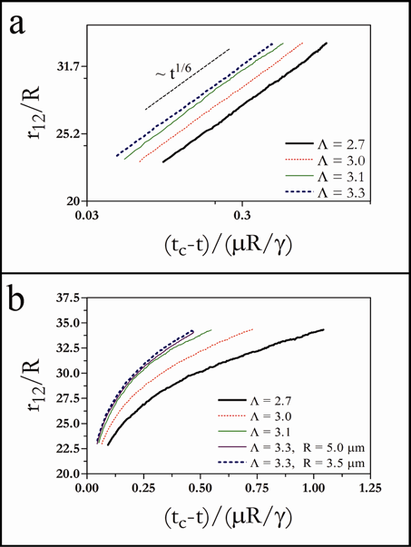
Far field: Quadrupolar Attraction
    ELLIPSOIDS: C. Loudet et al, PRL, 018301, 2005
Notes:
2 Power law slope
The slope of this power law can be related to the mode of the deformation that drives the attractin
This is done by equating the energy dissipated by viscous drag to the capillary interaction
The relevant slope for qps is 1/6; obeyed by particle trajectories

Slide 17
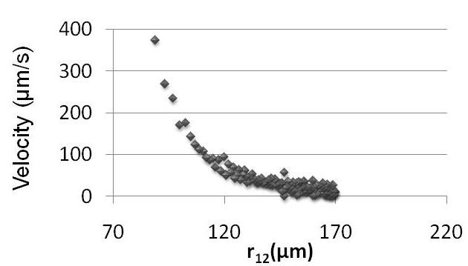
Extract magnitude of far field interaction energy
Viscous dissipation
C_{D}=1.73 for Λ=3 Heiss and Coull
Youngren and Acrivos
Cylinder~ 60% immersed
Capillary interaction energy
predicted
Asymptotic exp
Notes:
capillary force on the particle balances the Stokes drag.

Slide 18
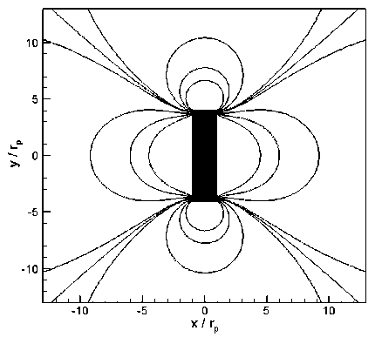
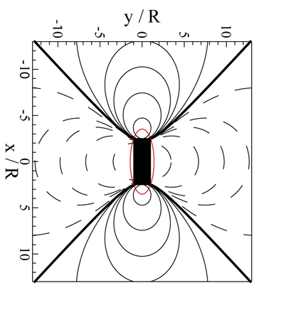
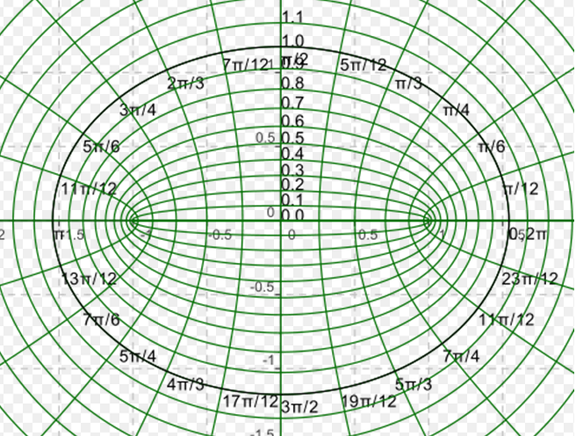
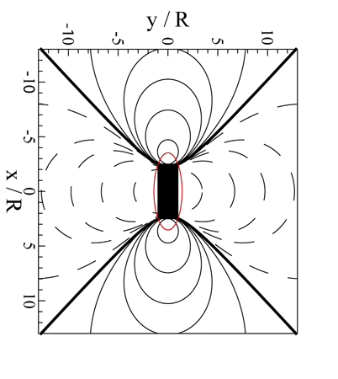
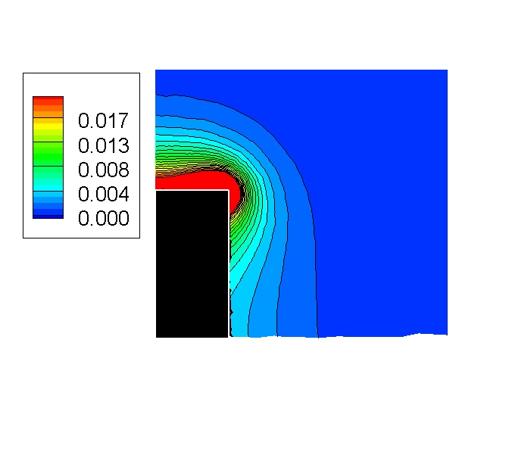
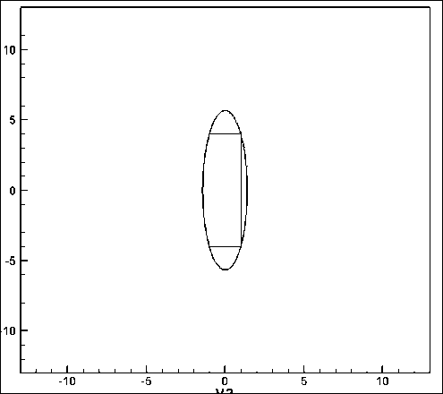
Divide deformation field into 2 domains:
exterior: elliptical quadrupolar deformation: 2-3 radii outside of ellipse circumscribing cylinder
– (very) far field: cylindrical polar qp
Isoheight
contours
around
cylinder
excess
area
map
Elliptical
quadrupolar deformation
near field: large area
concentration at ends
L:2R=5
Notes:
the area densities agree both qualitatively and quantitatively
(along the contour s=2.6s0, corresponding to an ellipse of major semi-axis equal to 5.5R, the maximum error is less than 8%, and it decreases at large distances). However, near the particle surface differences emerge.
Within 3 radii of the cylinder surfaces, the exact solution for the interfacial deformation and the elliptical quadrupolar mode agree to within 8% for cylinders of aspect ratio 3; agreement improves rapidly farther from the particle. This motivates the use of the pair potential based on interacting elliptical quadrupolar deformations quite near to the particles- i.e. for center to center distances comparable to 12 radii. We justify this pair potential a posteriori by comparison to experiment.
We integrate to find the excess surface area of the interface between s=2.6s₀ (an ellipse of major semi-axis 5.5R, 3 radii longer than that of the particle) and the cylinder surface itself. The resulting excess surface energy is , which is on the same order of magnitude as that predicted by the elliptical quadrupole in the outer domain. Most of this energy (72%) is concentrated near the cylinder end face, where h>0 and the surface gradients are steepest. This concentration near the end face becomes more significant for larger aspect ratios. For example, for and =80º, approximately 88% of the excess surface area is concentrated in the region h>0 within an ellipse of major semi-axis 3 radii longer than that of the particle

Slide 19



Quadrupoles in Elliptical Coordinates: End-to-end until nr contact
Black line: simulation
Colored symbols: experiment
Trajectory computed as:
φ_{A}
φ_{A+}φ_{B}
Angle
(used experimentally measured drag coeffs f_{t} & f_{r})
φ_{B}
Dynamic simulation and experiment
Time (secs)
Simulation
Experiment
Rotation: very local; decays steeply
Not in real time (slowed down X4)
Lewandowski et al Langmuir 2010
Notes:
Simulation of two interacting quadrupoles to check the DYNAMICS OF APPROACH.
The particle position and orientation are updated explicitely in time by a straighforward Euler scheme.
Assumed (i) that the resistance matrix is diagonal, (ii) that rotation and translation are decoupled from a hydrodynamic point of view.
Drag coefficients from experiment
MOVIE: The particles approach each other and rotate, initially slowly. Then the torque on the particles increases so that the angular velocity increases until the particles join their ends. This plot- a quantitative comparison reveals slight differences.
drag coefficient to translation CD≈0.53; to rotation CD * =0.09
Details: Lewandowski et al Langmuir 2010

Slide 20



Quadrupoles in Elliptical Coordinates: Side-to-Side on close approach
Charged?
Ellipsoids: Loudet
Vermant
uncharged
Our analysis (ellip qps):
Tip-to-tip preferred for separations >major axis
Side-to-side preferred for separations < major axis
EQP not full story
Notes:
Ellipsoidal qps for ellipsoids in contact: r₁₂ decreases as rotate from tip to tip to side to side
Shallow energy for many angles: may be related to strong bending of ellipsoidal chains: (weak spring constant)
showed that, on relatively dilute interfaces, ellipsoidal particles assemble by capillary interactions to form chains with ellipsoids oriented either tip-to-tip (silica coated PS ellipsoids) or side-to-side (PS ellipsoids). The particles approach at rates in agreement with the pair potential derived by Stamou for tip-to-tip alignment. Differing power law approaches are reported for side-to-side approach.
Side-to-side assembly is shown to be the minimum energy configuration for a pair of identical ellipsoids in a numerical study. Analysis was used to define a projected, fixed location for the contact line thereby simplifying the numerical simulation of a pair of ellipses interacting through capillarity. The surface shape was expanded in elliptical multipoles appropriate for elongated particles. The amplitude of the elliptical quadrupolar mode, determined numerically, was larger by orders of magnitude than the other modes in the expansion. Interactions between a pair of identical ellipsoids (of aspect ratio 5.0 and contact angle 66º) were simulated; tip to tip assembly was favored for particle separations larger than the particle length, side to side assembly was favored for smaller center to center distances. Departures from the pair interactions derived by Stamou occur for center-to-center distances comparable to 2 particle lengths. Asymptotic behavior of fluctuation induced forces is reported.

Slide 21



Interface near contact
gradient magnitude
cylinder 1
cylinder 2
in-plane bending
capillary bridge
Lorenzo Botto, KJS, in prep
Notes:
The secret lies in the large surface rise at the end-face of the cylinder. A sort of half capillary bridge forms between two particles and to bend the two particles in plane I have to distort this bridge, and this costs energy.

Slide 22




Critical torque and yielding
PREDICTIONS:
yield torque T_{c}
Constant torque experiment
T>T_{c}
strain softening
critical bending moment
should break chain
(stress)
φ (strain)
cylinder should snap to side-to-side
Notes:
Chains should also display a yielding torque, beyond which the material strain softens and, again, the chain will snap to a configuration with the cylinders side-to-side.

Slide 23


Surfactant Mediated Arrest and Recovery of Capillary Interactions
PDA on pH 2: Insoluble Surfactant
Brewster Angle
Microscopy
Nguyen et al. PRL 1992, 4, 419

Slide 24


1. PDA creates a tangential immobile surface
2. NaOH deprotonates PDA (increased solubility)
3. SU-8 rods form ordered assemblies
Lewandowski et al Soft Matter 2009

Slide 25

Magnet integrated into chain
With Yao LU; w R LEHENY, unpublished

Slide 26



Microstructure: rod-like particles
cylinders
ellipsoids
“Polygonal” networks
“Bamboo ”
“Wormy ” chains- Jan Vermant
Private commun
water-in-oil emulsion drop
vs. sphero-cylinders
no deformation
no interactions
Rectangular arrays

Slide 27

Other shapes: Fourier modes
Lucassen
Colloids and Surfaces 65, 1992
  Interaction between sinusoidal contact lines
  liquid-vapor surface area minimized
  Frequency
  Amplitude
  In phase
  Particles end face registry
    Particle Recognition
φ
φ= 0

Slide 28






Complex Shapes: Registry
Far field interactions
Quadrupolar in nature
β = -3.75

Slide 29

Complex Shapes: Registry

Slide 30




Interfacial deflections around cylinder
n
t
Aspect ratio dictates preferred location: shortest face preferred
Steepest slope always on shortest face
Notes:
D/L= 1/3

Slide 31





Preferred alignment
Curved side to curved side
Flat side to flat side
Preferred location is shortest face

Slide 32



Surface Evolver Results: Confirm Slope Argument
Steepest slope always on shortest face
h
1
0.66
2.0
4.0
d

Slide 33





Cylinder alignment on curved interfaces
Glass Walls
Glass Walls
Langmuir 2008
Notes:
glass Trough
Water pins at Edges
Three phase contact line remains the same
Increasing volume leads to transformation from convex to concave
Rods rotate from perpendicular with respect to the walls to parallel

Slide 34





Cylinder alignment on curved interfaces
Notes:
D=7 microns, L=50 microns

Slide 35

γA_{LV} depends on cylinder alignment
A_{LV} for a quadrupole on curved interface in small slope limit
Torque
Two mechanical equilibria:
α=0 perpendicular to wall
α=π/2 parallel to wall
Stable state: depends on sign of C
in agreement with experiment
Notes:
The main points from this analysis are
ALV can be expressed as the sum of a part that is independent of alignment alpha and a part that goes as cos2alpha.
The coefficient depends on the sign of the curvature of the interface.
The system moves to minimize its energy, so the particle rotates to find its minimum energy position. The torque is the derivative of this expression with respect to alpha.

Slide 36






Alignment of ‘biscotti’ shaped particles
A saddle on a saddle
Notes:
Cylinder: D= 7 microns, L= 50 microns
Bread slice:

Slide 37

Alignment as a function of particle size
R_{particles}=3.5μm
-Background curvature 10³ times particle radius
Lewandowski et al. Langmuir 2008
Notes:
Get details of energy calculation: cylinder aspect ratio L/D=3; R of the surface =500D

Slide 38


Cylinder assembly on curved interfaces
weak
curvature
1
2
3
1
4
5
6
Strong
curvature
1
2
3
Notes:
Torque as rotate back to alignment is balanced by the viscous drag.
Upper image: D=15 microns; L=50 microns
Lower image: D=7 microns, L=7 microns

Slide 40
In summary,the particle contribution to the total energy is
This form reveals a structure that is very familiar in the study of electrostatics.
The force "interacts" with the height,
the torque "interacts" with the slope,
The quadrupole moment "interacts" with the curvature tensor.
The first term is leading order for heavy isotropic particles, and corresponds to that derived by
Nicholson.
The second term is important for anisotropic particles acted upon by an external torque.
For an anisotropic force- and torque-free particle, the first two terms are identically zero and the
particle contribution to the energy becomes
Botto

Slide 41



Conclusions
Ellipsoids vs. cylinders Cylinders: hierachy of interactions- elliptical quadrupolar/near field
Chaining: cemented by near field interactions
Preferred orientation: f(aspect ratio of particle)
Curvature gradients: Motion and alignment
Complex shapes: Registry of end-face features
shapes with corners
Current work:
  complex particles
  repulsion
  crowded surfaces-gels
  docking sites
  mechanics of assemblies
  scale
Cylinders
on water
drop in oil
Notes:
Integrated power supplies in photomultiplier power supplies
Ghetto rig: negative ion generator
Usually rectifier stage and multiplier- dc- any dc flow –corrosion-
Electrets- common polymers- saran wrap is an example of one that holds charge
permantly polarized polymer- use for lithography- ~100Vs give weak dipole

Slide 42




Open issues: gels, networks, rheology, dense packings
Charged Ellipsoids
percolating networks
open flower like structures
elastic, brittle interfaces
on a water drop in oil
Jan Vermant,
Gerry Fuller
at water-decane interface,
-becomes denser with time
Cylinders
-rectangular lattices
-ropes of chains
-open networks
at air water interface,
spread, compressed
to collapse
compression isotherms, rheology, role of charge
Other shapes
at air water interface,
with DPPC spread, compressed
on a water drop in oil

Slide 43



Far field: cylindrical polar quadrupolar mode
Extract Fourier modes from numerical solution:
r > 9R_{cyl}
r ~ 9R_{cyl}
At r ~ 9R_{cyl} , higher modes 5% contribution
Notes:
Long cylinder limit, open issue.
R_{p} = Lcyl/2
For aspect ratios under study, between around 2 and 3

Slide 44



Rate of approach: far field
Fixed Aspect Ratio
Varied Aspect Ratio
Λ
(t_{c}-t)
(t-t_{c})
Faster approach as Λ increases:
consistent with H_{p} increase

Slide 45




Interactions of elliptical quadrupoles vs. r₁₂
Solid line ends at tip-to-tip contact
end-to-end alignment favored
r₁₂/R
Torque enforces end to end alignment
Notes:
Analysis was used to define a projected, fixed location for the contact line thereby simplifying the numerical simulation of a pair of ellipses interacting through capillarity. The surface shape was expanded in elliptical multipoles appropriate for elongated particles. The amplitude of the elliptical quadrupolar mode, determined numerically, was larger by orders of magnitude than the other modes in the expansion. Interactions between a pair of identical ellipsoids (of aspect ratio 5.0 and contact angle 66º) were simulated; tip to tip assembly was favored for particle separations larger than the particle length, side to side assembly was favored for smaller center to center distances. Departures from the pair interactions derived by Stamou occur for center-to-center distances comparable to 2 particle lengths. Asymptotic behavior of fluctuation induced forces is reported.
Contact line, Lehle:
However, the Lehle’s analysis^{(REF)} indicates that the projection of the contact line is approximately an ellipse with major semiaxis a’ and eccentricity e’ (depending on particle geometry and contact angle) for which and . For contact angle sufficiently close to 90, and a’ are numerically e’ very close to and a and e, and the projected contact line deviates only weakly from an ellipse of aspect ratio =5.

Slide 46

Steric effects
Steric effects imposed by
anisotropic hard core repulsion
Potential= Ellip Quadrupoles+
Repulsion preventing contact
ε=0.2
Notes:
The equation for the superellipse is
((x/a)^(2/e)+(y/b)^(2/e))^e=1
e =1 ellipse (or sphere for a=b)
e ->0 cylinder
I think this representation has been around for more than a while (like, maybe centuries), but definitely the guy to cite is Torquato (princeton), who is an important in jamming of anisotropic particles.
For example
Optimal packings of superballs :)
PHYSICAL REVIEW E 79, 041309 2009, Y. Jiao,1 F. H. Stillinger,2 and S. Torquato2,3,4,5
I didn't check if my algorithm was used by others before, but similar ideas are in the literature.
Repulsion preventing contact constuctructed:
Superellipses: creates level set locating particle surface:F=0
Soft collision which approaches hard core repulsion as steepen the range of the repulsive force to be quite local
Find overlap between particles: impose a repulsive potential which diminishes (more steeply than linearly) with the scale of that overlap
When the scale of the overlap is zero, the repulsive potential is zero
Faithfully follows F=0

Slide 47

Asymptotics of interaction energy
L/D
Expansion in powers of 1/r₁₂ :
Torque decays faster (as 1/r⁶) than force (1/r⁵)
Torque has strong aspect ratio (Λ=L/D) dependence
Notes:
To derive an approximately an expression for the torque as a function of the distance, perform an asymptotic expansion in terms of the interparticle separation. To O(1/r4), the energies in the end-to-end and side-to-side are equal.
Differences appear to O(1/r6). Therefore the torque between distant particles decays as r-6, in contrast to the force which decays slower (as r-5).
However the torque has a stronger dependence on aspect ratio than the force. This may be important for dense systems, as the particle might find a final configuration by rotating, other than translating.

Slide 48
Anisotropic pair potential
after contact
before contact
Tip contact
10⁴ kT
End-to-end favored until tip-to-tip contact
(Langmuir 2010)

