Slide 1
Low dimensional quantum gases
T. Giamarchi
http://dqmp.unige.ch/giamarchi/
TexPoint fonts used in EMF.
Read the TexPoint manual before you delete this box.: AAAAAAA

Slide 2
Plan of the lectures
Equilibrium, basic notions of Tomonaga-Luttinger liquid
More on TLL (factionalization, topology, etc.)
Effect of perturbations (Lattice and disorder)
Notions of transport in 1D
From 1D to 3D; Ladders; Dimensional crossover

Slide 3
Why one dimension ?

Slide 4
Three urban legends about 1D
It is a toy model to understand higher dimensional systems.
It does not exist in nature ! This is only for theorists !
Everything is understood there anyway !

Slide 5

One dimension is specially interesting
No individual excitation can exist (only collective ones)
Strong quantum fluctuations
Difficult to order

Slide 6
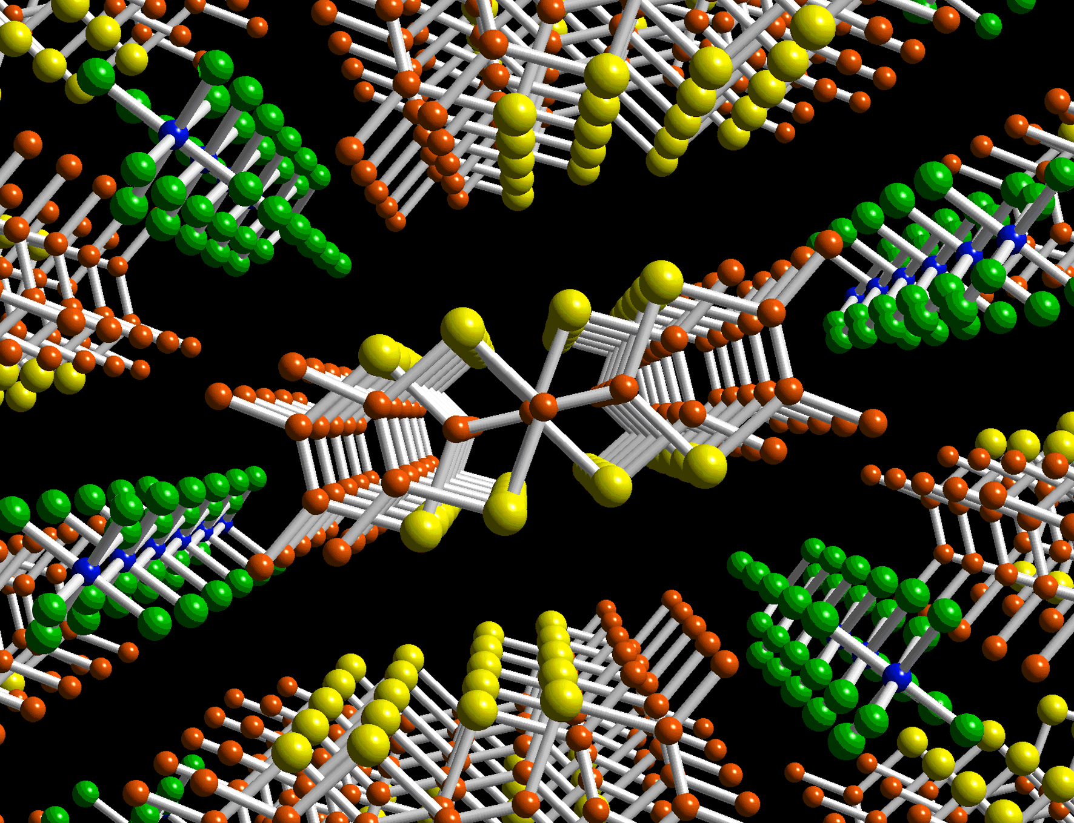
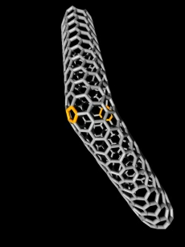
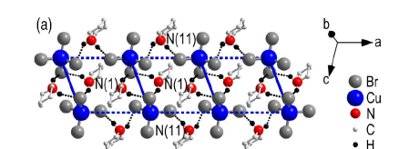
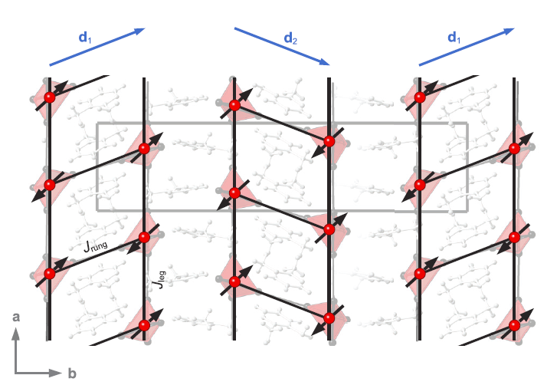
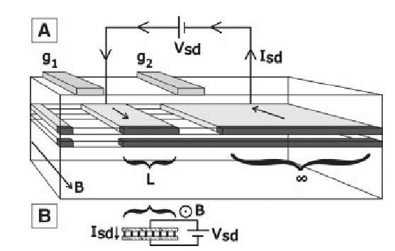
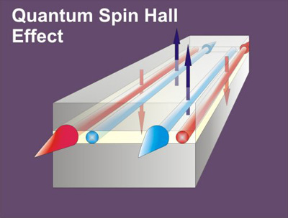
Many CM or cold atoms Systems
b
c

Slide 7
Drastic evolution of the 1d world
New methods (DMRG, correlations from BA, etc.)
New systems (cold atoms, magnetic insulators, etc.)
New questions (strong SOC, out of equilibrium, etc)

Slide 8
How to treat ?

Slide 9
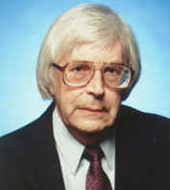
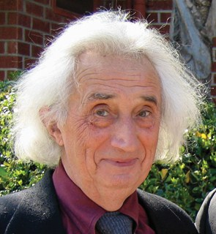

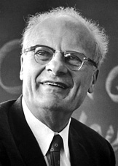


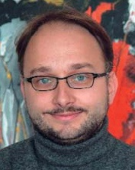
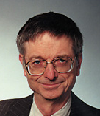

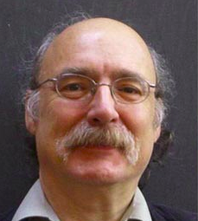
``Standard’’ many body theory
Exact Solutions (Bethe ansatz)
Field theories
(bosonization, CFT)
Numerics
(DMRG, MC, etc.)

Slide 10
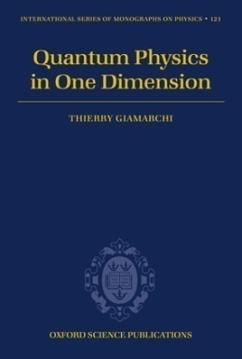
References
TG, Quantum physics in one
dimension, Oxford (2004)
TG in ``Understanding Q. Phase Transitions’’, Ed. L. Carr, CRC Press (2010)
M. Cazalilla et al.,
Rev. Mod. Phys.83 1405 (2011)
TG, Int J. Mod. Phys. B 26 1244004 (2012)
TG, C. R. Acad. Sci. 17 322 (2016)

Slide 11
And now we start….

Slide 12
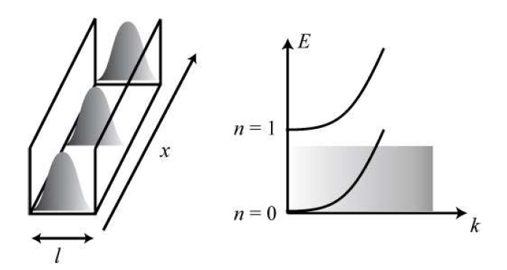

Slide 13
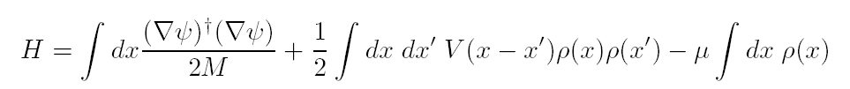
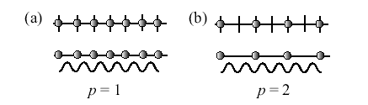
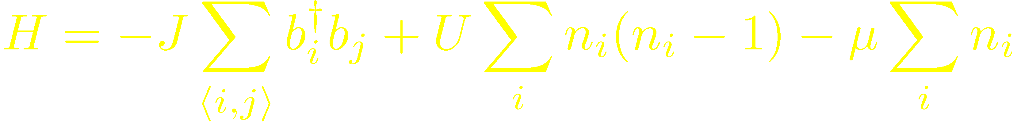
Typical problem (e.g. Bosons)
Continuum:
Lattice:

Slide 14
Luttinger liquid physics

Slide 15
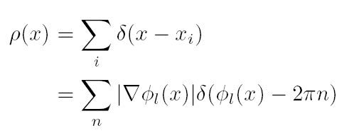
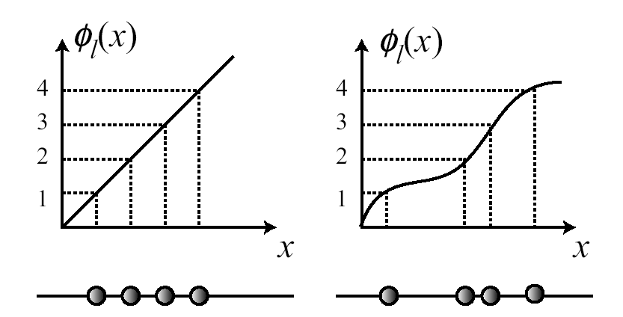
Labelling the particles
1D: unique way of labelling

Slide 16

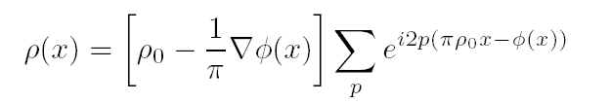
φ(x) varies slowly
CDW

Slide 17


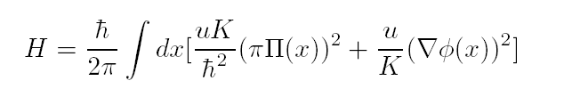
θ: superfluid phase
Quantum fluctuations
U
0
1
K
1
1

Slide 18
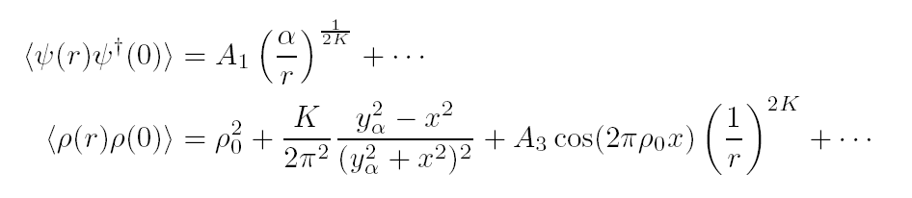
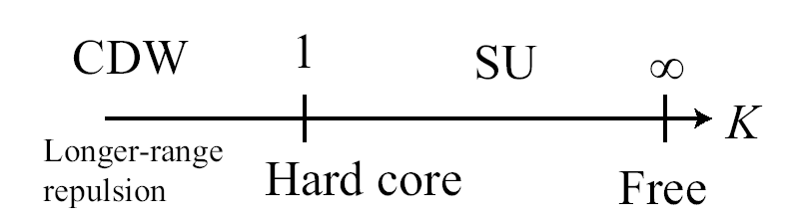
Correlations
1/2

Slide 19
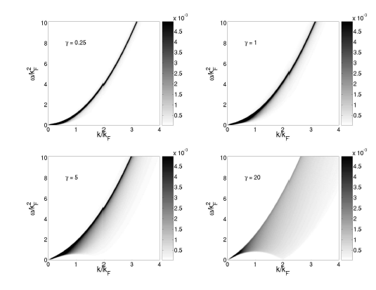
S(q,!) J.S. Caux et al PRA 74 031605 (2006)

Slide 20
Finite temperature
Conformal theory
β
χ

Slide 21
Other 1D systems

Slide 22
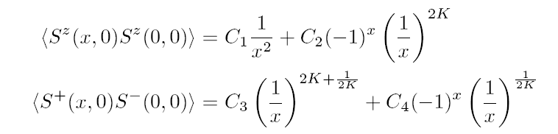
Spins
Use boson or fermions mapping
Powerlaw correlation functions
Non universal exponents K(h,J)

Slide 23
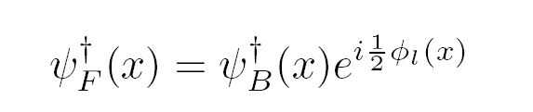
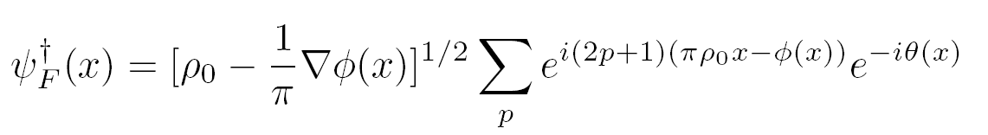
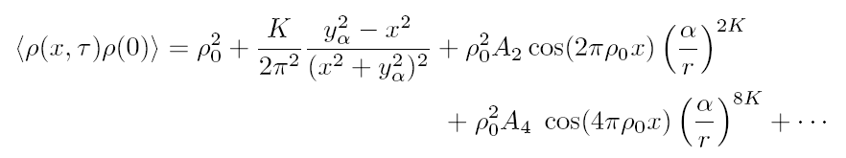
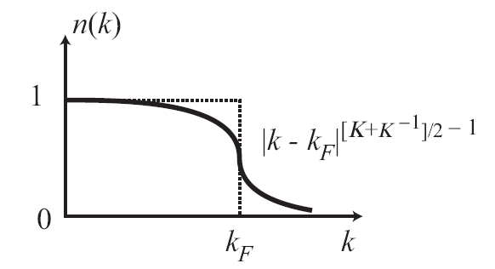
Fermions
Right (+k_{F}) and left (-k_{F}) particles

Slide 24
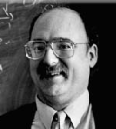
Luttinger liquid concept
How much is perturbative ?
Nothing (Haldane):
provided the correct u,K are used
Low energy properties: Luttinger liquid (fermions, bosons, spins…)

Slide 25
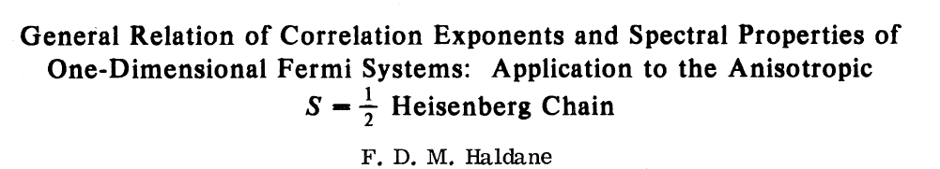
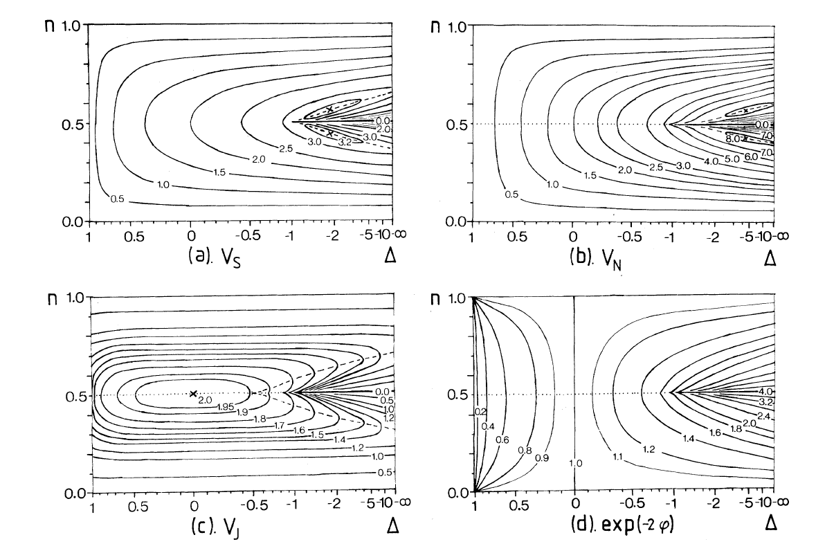
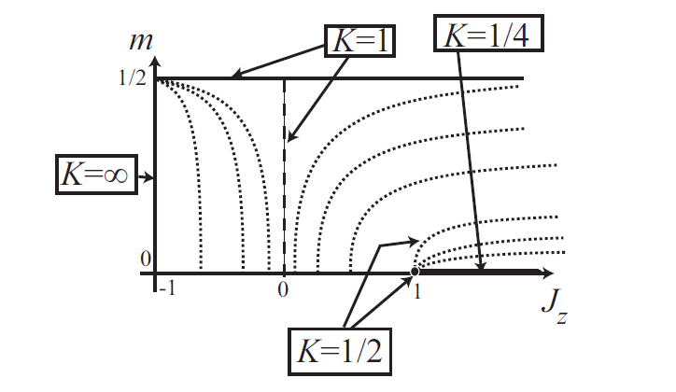
Luttinger parameters

Slide 26
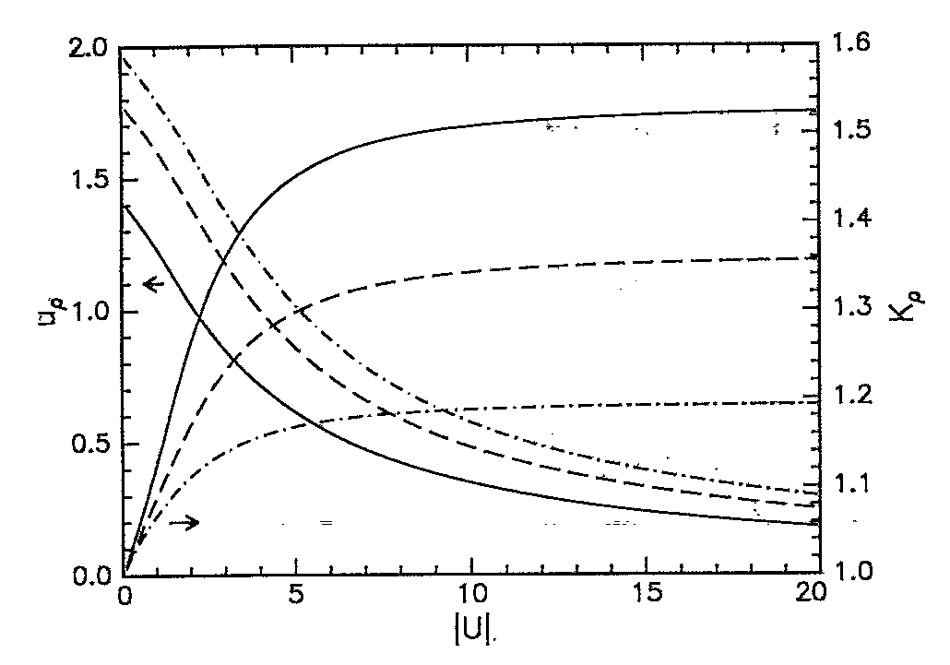
Attractive Hubbard model
TG + B. S. Shastry PRB 51 10915 (1995)

Slide 27
``Quantitative’’ theory possible
Trick: use thermodynamics and BA or numerics
Compressibility: u/K
Response to a twist in boundary: u K
Specific heat : T/u
Etc.

Slide 28
Tonks limit
U = 1 : spinless fermions
Not for n(k) : ψ_{F} ≠ ψ_{B}
Free fermions:
K=1
Note:

Slide 29
Tests of Luttinger liquids

Slide 30
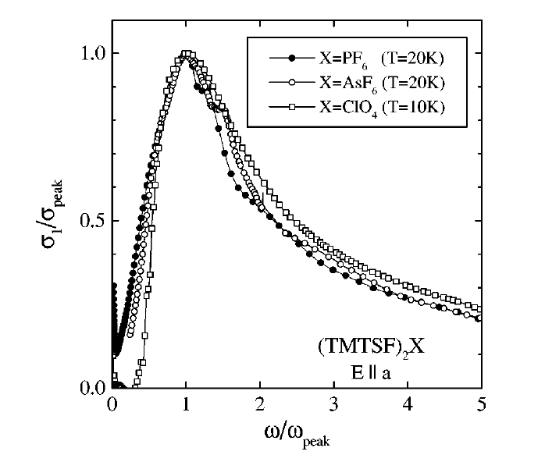
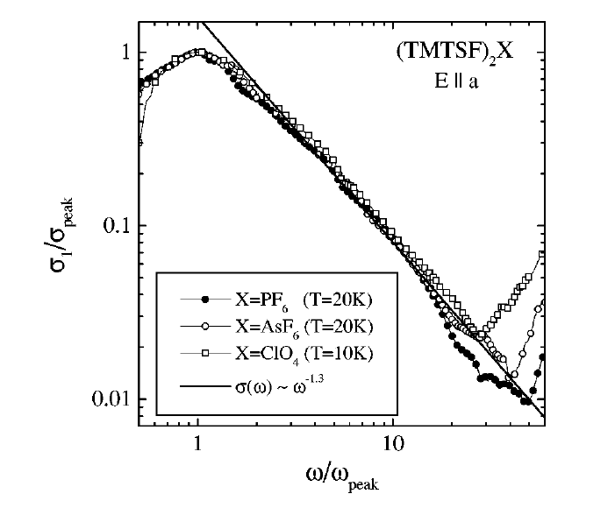
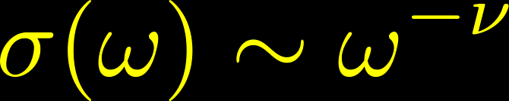
Organic conductors
b
c
TG PRB (91) :
Physica B 230 (1996)
A. Schwartz et al. PRB 58 1261 (1998)
First observation of LL/powerlaw !!

Slide 31
Cold gases

Slide 32

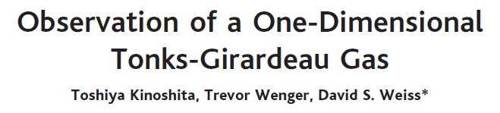
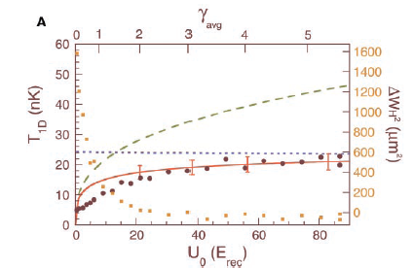
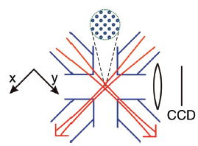
Bosons (continuum)

Slide 33
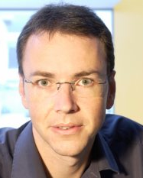
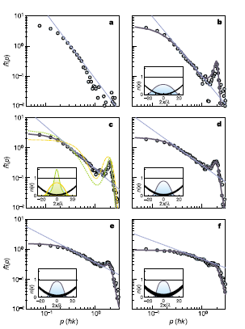
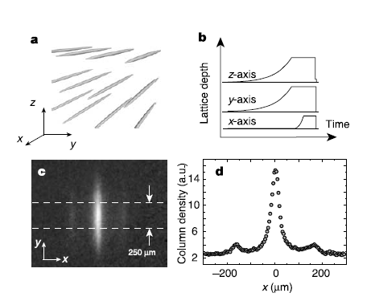
Optical lattices (dilute)
B. Paredes et al., Nature 429 277 (2004)

Slide 34
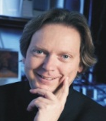
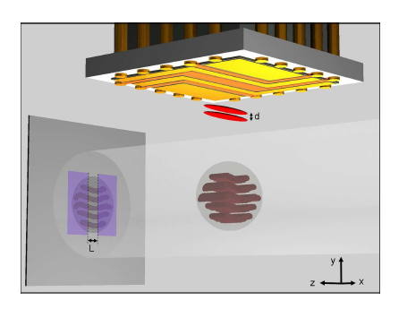
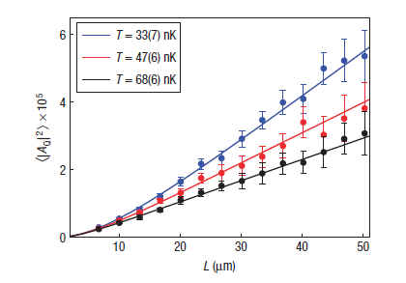


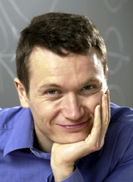
Atom chips
S. Hofferberth et al. Nat. Phys 4 489 (2008)
K large (42)

Slide 35


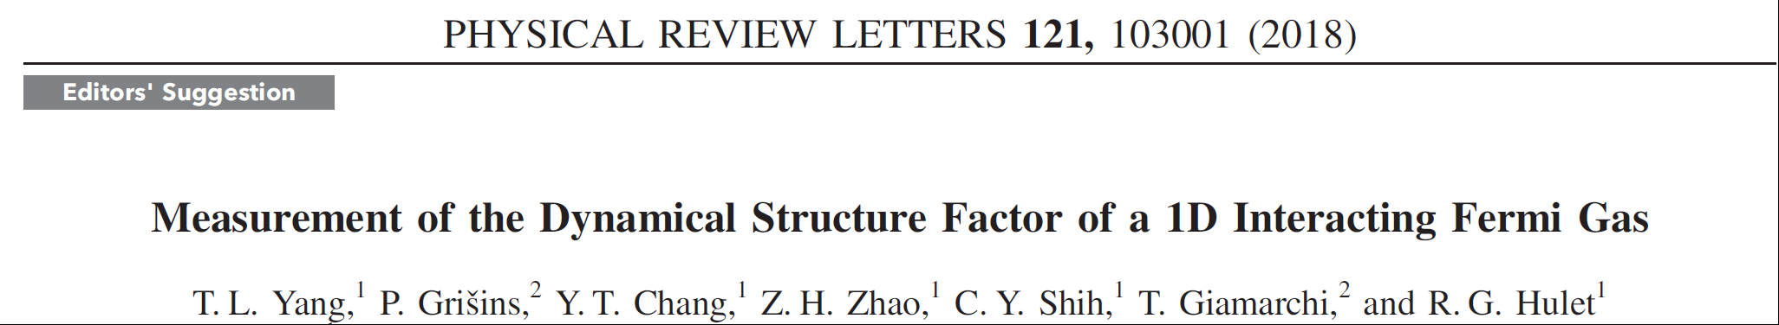
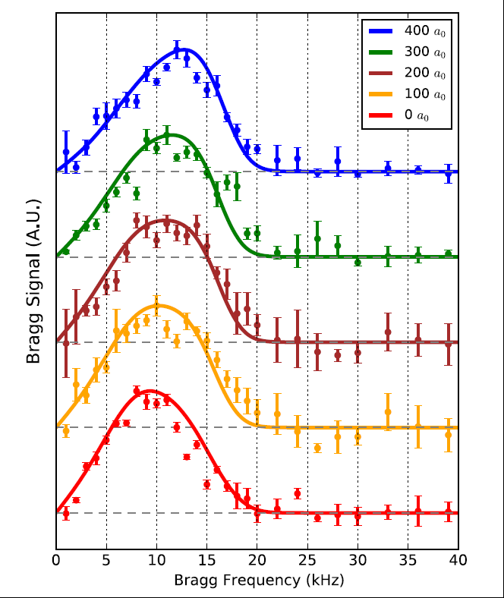
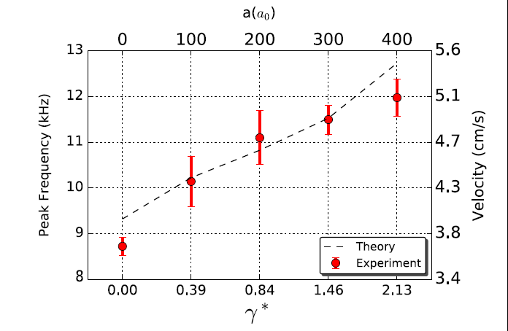

Charge velocity
https://www.futurity.org/one-dimensional-electrons-physics-1858622/

Slide 36
Other important 1D properties
Fractionalization of excitations

Slide 37
Fractionalization of excitations
Magnon
Spinons

Slide 38

Magnons and spinons: 1 = ½ + ½
Hidden (topological) order parameters
Continuum of excitations
E(k) = cos(k₁) + cos(k₂)
k = k₁ + k₂

Slide 39
Spin
Deconstruction of the electron:
spin-charge separation
Charge
Spinon
Holon

Slide 40




arXiv:1605.05661v2

Slide 41


Doped Hubbard model

Slide 42
Spin
Spin-Charge Separation
higher D ?
Charge
Energy increases with spin-charge separation
Confinement of spin-charge: « quasiparticle »

Slide 43


Confinement of spinons BaCoVO
Q. Faure, S. Takayoshi, et al. Nat. Phys 14, 716 (2018)

Slide 44
Take home message
Good theoretical methods to deal with the case of a ``simple’’ equilibrium 1d systems (analytics and numerics)
Stepping stone to go beyond: many exciting questions and problems (out of equilibrium, disorder, many chains, etc.)
Controled experimental realizations in condensed matter and cold atoms

Slide 45
Effect of lattices:
Mott transition

Slide 46

Mott transition
T
?
δ = n-1
Mott insulator (n=1)
T < T_N : antiferromagnetic phase

Slide 47
Periodic lattice
Incommensurate: Q ≠ 2 π ρ₀
Commensutate: Q = 2 π ρ₀

Slide 48

Competition
Beresinskii-Kosterlitz-Thouless transition at K=2
String order
parameter

Slide 49



BKT transition
BKT: remarkable transision going outside the paradigm of Landau’s phase transitions
A transition wihout an order parameter
Topological Vortex excitations
Phase transition without order parameter

Slide 50
Vortex operator
τ
2π
0
Vortex operator for θ
x
K : inverse temperature
g : vortex fugacity

Slide 51

Mott insulator:
φ is locked
Density is fixed
TG, Physica B
230 975(97):
arXiv/0605472 (Salerno lectures);
Oxford (2004);
M. Cazalilla et al.,
Rev. Mod. Phys.83 1405 (2011)
T. Kuhner et al. PRB 61 12474 (2000)
Gap in the excitation spectrum

Slide 52






E. Haller et al. Nature 466 597 (2010)
Renormalized Sine-Gordon
Shows:
K* = 2
G. Boeris et al. PRA 93 93, 011601(R) (2016)

Slide 53




Non local (topological) order
Science (2011)

Slide 54


Topological excitations is the norm in 1D

Slide 55
Disorder (equilibrium)

Slide 56

Example: localization of 1D interacting bosons
TG + H. J. Schulz EPL 3 1287 (1987); PRB 37 325 (1988)
Competition Disorder vs Interactions
Existence of a Many-Body localized phase: Bose glass

Slide 57

Bose glass phase
D_{b}
Bose Glass
Superfluid
U_{c}
U [interactions]
0

Slide 58


Other potentials: Biperiodics
U= 0
Aubry-André model
Localization transition
Effect of interactions?
Same as ``true’’ disorder ?
J. Vidal, D. Mouhanna, TG PRL 83 3908 (1999); PRB 65 014201 (2001)
G. Roux et al. PRA 78 023628 (2008);
T. Roscilde, Phys. Rev. A 77, 063605 2008;
X. Deng et al PRA 78, 013625 (2008);

Slide 59









Quasi-periodics and interactions
C. D’Errico, E. Lucioni et al. PRL (2014);
L. Gori et al PRA 93 033650 (2016)

Slide 60





Slide 61
d.c. transport at finite T
In 1D all states are exponentially localized
Finite T: sweeps energy E with probability f(E)
No interactions σ(T)=0 for all T !
Needs coupling to a thermal bath (phonons, etc.)
Or with interactions can the system be its own thermal bath ?

Slide 62
With a bath

Slide 63

d.c. transport (high T)
TG + H. J. Schulz EPL 3 1287 (1987); PRB 37 325 (1988)

Slide 64







Transport with a Thermostat
Mott variable range hopping
1D with interactions
T. Nattermann, TG, P. Le doussal, PRL 91, 056603 (2003)
arXiv:cond-mat/0403487

Slide 65
Without a bath
With interactions can other particles be a ``bath’’ for one particle ?
Can the system reach the thermodynamic equilibrium ? And explore ergodically the phase space ?

Slide 66
Many body localization
Basko, Aleiner, Altshuler; Gornyi, Mirlin Polyakov; Huse, ……
Dmitry A. Abanin, Ehud Altman, Immanuel Bloch, and Maksym Serbyn, Rev. Mod. Phys. 91, 021001 (2019)
No thermostat σ(T) = 0 if T<T* even with interactions
The system is not ergodic even at finite temperatures/energies

Slide 67
Take home message
Remarkable interplay between localization and interactions
Consequences and challenges both in equilibrium (LIP) and out of equilibrium (MBL).
Experimental possibilities to explore these phenomena
Need better tools !

Slide 68
Transport

Slide 69

Transport
Condensed matter: a «routine» probe for materials
Theoretically:
complicated !
Out of equilibrium
Typical situation
Often (but not always !) : linear response I=G V

Slide 70
Questions
I=f(V) Reflects the properties of the system
(interferences – metal, insulator, etc.)
Methods ?
Kubo; Memory function; Landauer; Keldysh; …..
Expectations for small V:
Other transport(s): spin, temperature, etc.

Slide 71







Cold atoms

Slide 72






1D ballistic: quantized conductance

Slide 73



Atomtronic
M. Lebrat, P. Grisins et al., PRX 8 011053 (18)

Slide 74




No interactions: band insulator

Slide 75



What happens with interactions?

Slide 76



Luther-Emery liquid
Gap in the spin sector (singlet pairing)
Conductance determined by the charge sector

Slide 77

Many-body insulator
``pinned’’ L.E. liquid

Slide 78

Experimental evidence for L.E. liquid
Notes:
the Gaudin-Yang parameter at the wire center is equal to -1.7;-1.9;-2.3;-2.6 and -3:0

Slide 79

Spin transport
A.-M. Visuri, M. Lebrat, S. Häusler, L. Corman and TG, PRR 2, 023062 (2020)

Slide 80




Spin transport and spin drag
Spin Drag:

Slide 81




Solution (using Sine-Gordon)

Slide 82


Comparison with experiments
Notes:
L=5.5 \mu m T=55 nK \rho_0 = 1.6 / \mu m

Slide 83








Lindblad reservoirs and losses
T. Jin, M. Filippone, TG PRB 102 205131 (2021)
T. Jin, J. Ferreira, M. Filippone, TG arxiv/2106.14765
Ballistic ?
Diffusive ?

Slide 84
Artificial gauge fields

Slide 85


Meissner effect in bosonic ladders
E. Orignac, TG, PRB 64 144515 (2001)

Slide 86



Slide 87

Orbital currents (``Meissner’’ effect)
Field ``Hc1’’: appearance of vortices

Slide 88



Artificial gauge field (cold atoms)
M Atala et al. Nat Phys, 10 588 (2014)

Slide 89

Hall effect
Non interacting ``simple’’
No interactions: curvature of fermi surface
- topological formula (Thouless-Kohmoto)
With interactions: open question

Slide 90


Hall effect: measurements
Notes:
Spielman 87Rb atoms

Slide 91




Hall effect on ladders
S. Greshner, M. Filippone, TG, PRL 122, 083402 (19)
Analytic: calculation on a ring
Experiments: out of equilibrium

Slide 92




Vanishing Hall response
M. Filippone, C.E. Bardyn, S. Greshner, TG, PRL 123, 086803 (19)
Exact zero of the Hall effect for LB geometry

Slide 93





Hall votage vs polarization
M. Buser, S. Greshner, U. Schollwöck, TG, PRL 126, 030501 (21)
Practical protocol to compute Hall voltage Vh from Hall polarization Ph

Slide 94
Dimensional crossover

Slide 95
Largely open physics
Strong difficulties to treat (analytics, numeric)
Allows to incorporate SOC and magnetic field effects
Many studies limited to non-interacting case
Relevant for many experimental systems

Slide 96

Deconfinement
b
c
TG Chemical Review 104 5037 (2004)
D. Jaccard et al., J. Phys. C, 13 L89 (2001)

Slide 97

Deconfinement
TG Chemical Review 104 5037 (2004)
P. Auban-Senzier, D. Jérome, C. Carcel and J.M. Fabre J de Physique IV, (2004)
A. Pashkin, M. Dressel, M. Hanfland, C. A. Kuntscher, PRB 81 125109 (2010)

Slide 98


Chain (Cluster) - DMFT
S. Biermann, A. Georges, A. Lichtenstein, TG, PRL 87 276405 (2001)
C. Berthod et al. PRL 97, 136401 (2006)
Bath must be self consistently determined

Slide 99
Transverse transport
Perpendicular hopping t’
T > t’: tunneling, not usual transport

Slide 100




DMRG

Slide 101
Conclusions
Tour of one dimensional physics
Luttinger liquid theory provides a framework to study this physics, and to go beyond
Beautiful open problems: out of equilibrium, disorder, coupled chains, impurities, etc. ……
Requires interplay of analytical and numerical techniques (and new ideas!) to make progress
Remarkable and complementary realization in condensed matter and cold atomic gases

