Slide 1

Frustrated Magnetism
Ashvin Vishwanath
UC Berkeley
Acknowledgements: Fa Wang (MIT), Frank Pollman (Dresden), Arun Paramekanti (Toronto), Roger Melko & Anton Burkov (Waterloo), Donna Sheng (Northridge), Leon Balents (KITP).

Slide 2
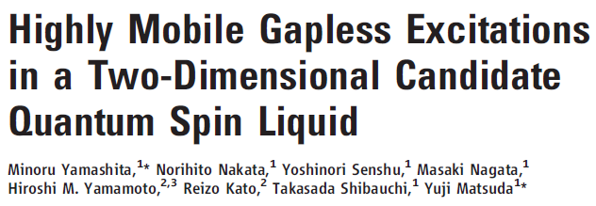

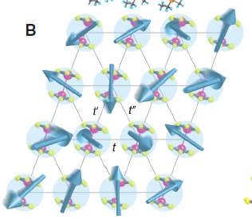
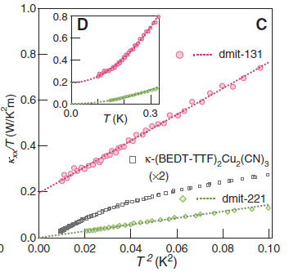
Preview – Quantum Spin Liquids
A triangular lattice magnet
Recent development: An electrical insulator, which conducts heat like a metal!

Slide 3
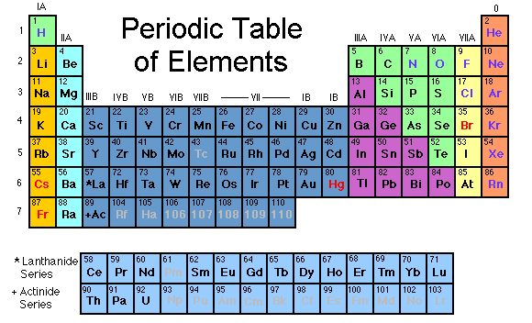
Magnetic Insulators
Mott Insulators – Coulomb repulsion localizes electrons to atomic sites. Only spin degree of freedom.
t
e⁻
Mott Insulator: U>t
U
U
Typically, oxides of transition metals (Fe, Co, Ni, Mn, Cu etc.)

Slide 4
Magnetic Insulators
Only spin degree of freedom. Simplest quantum many body system!
Typically, spins order :
  Except in frustrated systems
Example: La₂CuO₄ (parent compound of cuprates)
t
e⁻
Opposite Spins gain by virtual hopping:
J≈t²/U; H = J S₁•S₂
S=1/2 square lattice anti-ferromagnet
.J ≈ 1,000Kelvin; t,U ≈10,000 Kelvin

Slide 5
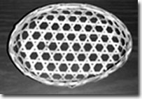
Geometric Frustration
Frustration ~ cannot optimize all energetic requirements simultaneously.
(Classical Spin)
Triangular Lattice:
Kagome Lattice:
#of ground states= (N sites)
Accidental degeneracy of classical ground states

Slide 6
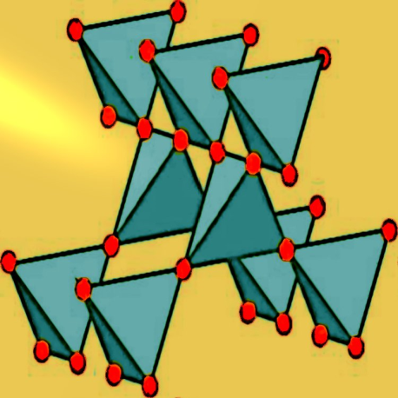
Geometric Frustration
Today, mainly Ising Spins (S=+1, -1)
Note, Heisenberg spins:
Triangular Lattice:
(now, unfrustrated – unique ground state, upto symmetries)
Kagome Lattice:
Pyrochlore Lattice:
Frustrated ((spins on a triangle must sum to zero)
Frustrated (spins on a tetrahedron must sum to zero)

Slide 7
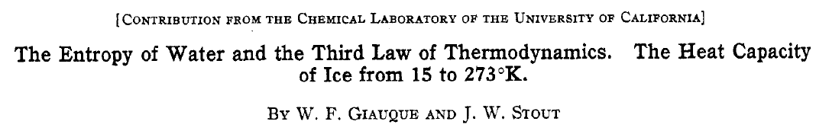

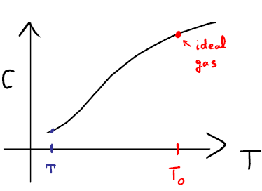
Geometrical Frustration in Ice
Residual Entropy of Ice (1936):
Third law of Thermodynamics: S₀→0

Slide 8
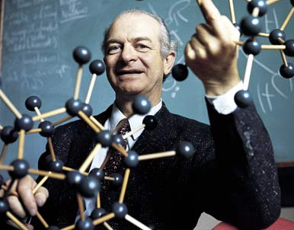
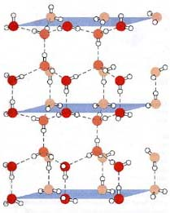
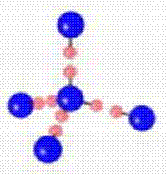
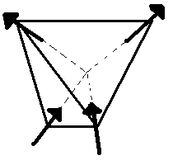
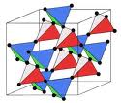
Geometrical Frustration in Ice
Pauling’s Solution:
Structure:
Bernal Fowler Rules – 2 H near, 2 H far.
Oxygen
Hydrogen
Alternate H site
Idea: Hydrogens remain disordered giving entropy
Spin version: Spin ice (Ho₂Ti₂O₇)
Ho

Slide 9
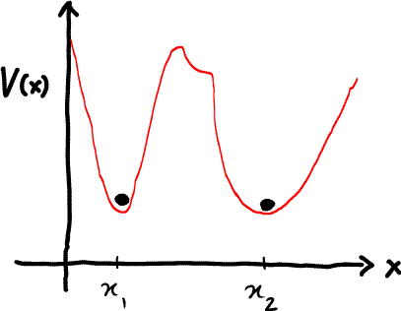
Geometric Frustration & Relief
Outline
1. Frustration relief by residual interactions
  here - complex orders from lattice couplings in CuFeO₂
2. Selection by quantum/thermal fluctuations
here – ‘supersolid’ order by disorder.
Classically degenerate
Complex orders - but defined by Landau order parameter.

Slide 10
Geometric Frustration & Relief
Outline
3. Quantum spin liquids.
No Landau order parameter.
Alternate descriptions?
Depends on the spin liquid!
eg. Topological order OR
Gapless excitations unrelated to symmetry
Gauge theories emerge (Tomorrow)
Strong tunneling

Slide 11
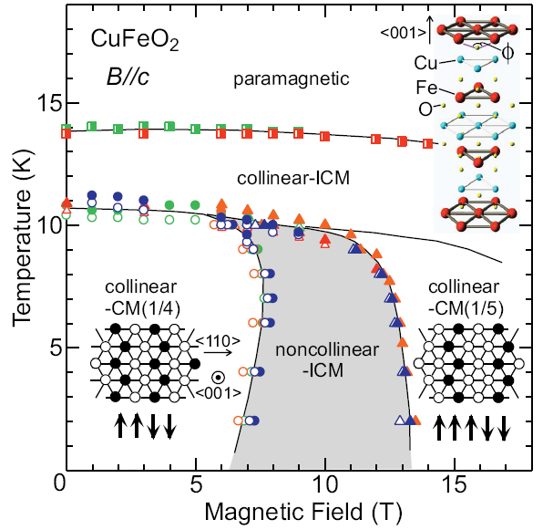
Frustration and Relief - Lattice coupling
Tchernyshyov et al., Penc et al., Bergmann et al. for pyrochlore
Restoring force
Change in J
Seen in Triangular lattice material CuFeO₂
Optimal Configuration?
Z state
Zigzag stripes
Fa Wang and AV, PRL (08).

Slide 12
Magnetization Plateaus and CuFeO₂
Spin-Phonon model:
m
Good agreement with known phases of Triangular magnet CuFeO_{2.}
Prediction for 1/3 plateau structure.
h/J
1
2
3
c=0.15, D_{z}=0.01J
Z state
Fa Wang and AV, PRL 2008

Slide 13
Complex Phase Structure of Triangular Spin Phonon Model
Violations of “Gibbs Phase Rule” (4 phases meet at a point – due to frustration)
  E₁ - E₂= E₂ - E₃= 0 (requires 2 parameters)
  E₄ - E₃= E₄ – E₁= 0 (accidental degeneracy – frustration)
  Also, on Kagome
Spin-phonon Phase Diagram in a field
(numerical Monte Carlo – simulated annealing)

Slide 14
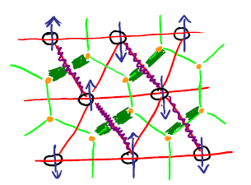
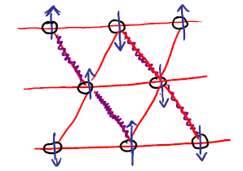
XXZ Model on triangular lattice
Anderson and Fazekas (1973) [Resonating Valence Bond – spin liquid proposal]. Highly anisotropic triangular lattice antiferromagnet:
Project into Ising ground state manifold. Treat J as a perturbation.
Groundstates: Hardcore Dimers on the Honeycomb lattice (2 to 1 map)

Slide 15
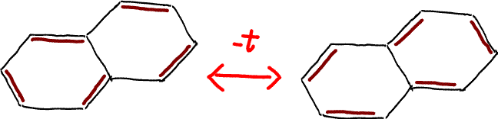

XXZ Model on triangular lattice
Quantum Dynamics from J term
J
Anderson-Fazekas proposal: Ground state superposition of different dimer coverings (Resonanting Valence Bonds - RVB)
Note, J>0 has a sign problem
Consider J<0, no sign problem! Solve for ground state.
Map J>0 to J<0 problem, in Hilbert space of Ising ground states.
Solve model for J<0; more naturally viewed as a boson model with hopping t=-2J

Slide 16
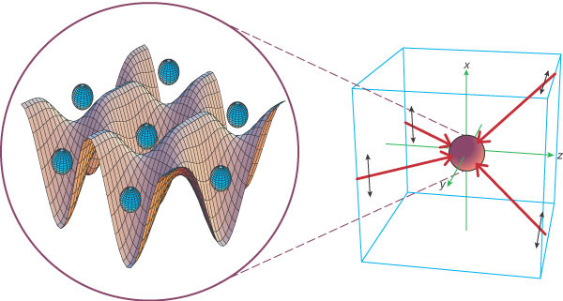
Spin-Boson Mapping
Spin-boson mapping:
Repulsion
Quantum Fluctuation: Boson hopping
Bosons on the Triangular lattice:
Physical Realization: Ultra-cold Dipolar Atoms in an optical lattice?
t=0 highly frustrated

Slide 17
Supersolid order on the triangular lattice
Case 1. If t >>J_{z}
uniform superfluid
Case 2. If J_{z} >>t
Expect a solid. Charge order (m)
No sign problem – large system sizes can be studied with Quantum Monte Carlo
Melko, Paramekanti, Burkov, A.V., Sheng and Balents, PRL 06; Haiderian and Damle; Wessel and Troyer

Slide 18
Supersolid order on the triangular lattice
Case 1. If t >>J_{z}
uniform superfluid
Case 2. If J_{z} >>t
Charge order (m)
AND superfluid (ρ_{s})
high & low density
superfluid
lattice supersolid
J_{z}/t
(Quantum Monte Carlo)
9
t=1/2

Slide 19
Triangular Lattice bosons with Frustrated Hopping
+
XXZ antiferromagnet on the triangular lattice
Sign Problem – cannot use Quantum Monte Carlo.
However, in the limit J_{z} >>t , a unitary transformation exists – that reverses the sign. Only works in the space of Ising ground states (dimer states) – projector P.
Fa Wang, Frank Pollman, AV, PRL 09. & D. Sheng et al. PRB 09.

Slide 20
Triangular Lattice XXZ Model at J_{z}>>J
Unitary transformation:
  Diagonal in S_{z} basis.
  Thermodynamics of +t and –t models identical
Only in the limit J_{z} >>t
(ground state sector of Ising antiferromagnet)

Slide 21
Triangular Lattice bosons with Frustrated Hopping
Immediate Implications for +t
  Ground state also has same solid order (U diagonal in density/S_{z} basis) as -t
  Same superfluid density at +t as –t (free energy with vector potential: F[A] identical)
  Also a SuperSolid
Nature of Supersolid order: obtained using a variational wavefunction approach (A. Sen et al. PRL (08), for the unfrustrated case)
  Excellent energetics/correlations for unfrustrated case.
Correlation functions evaluated using Grassman techniques invented to solve 2D dimer stat-mech.

Slide 22
Phase Diagram of the XXZ Antiferromagnet
XXZ antiferromagnet
Ordering pattern obtained near t/J_{z}=0. If we include t/J_{z}=-1/2 (Heisenberg point) with 120º order. Can be connected smoothly.
Anisotropic XXZ S=1/2 Heisenberg magnet is ordered – deformed 120º order. Not a spin liquid.

Slide 23
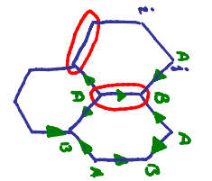
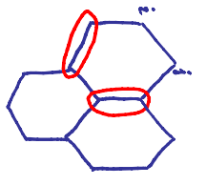
Connection to Lattice Gauge Theories
Hardcore Dimer model (on bond ij)
On a bipartite lattice:
  Define a vector field e
Gauss Law
Realized quantum electrodynamics on D=2 Lattice. Also called U(1) gauge theory.

Slide 24
Confinement and Spin Liquid Phase
Lattice gauge theories – two possible phases:
  Confined phase – electric fields frozen. (magnetic order)
  Coulomb phase (gapless photon excitation as in Maxwell’s electrodynamics) (Spin liquid)
Remarkable general result (A. Polyakov)
  In D=2, lattice electrodynamics (U(1) gauge theory), has only one phase – confined phase.
  Spin liquid very unlikely in Anderson-Fazekas model.

Slide 25
Beating confinement
To obtain deconfinement
  Consider other gauge groups like Z₂ (eg. non-bipartite dimer models)
  Go to D=3 [spin ice related models]
  Add other excitations. [deconfined critical points, critical spin liquids]
  References:
  J. Kogut, “Introduction to Lattice Gauge Theories and Spin Systems” RMP, Vol 51, 659 (1979).
  S. Sachdev, “Quantum phases and phase transitions of Mott insulators “, page 15-29 [mapping spin models to gauge theories]
  We will discuss each of these tomorrow

