Slide 1
Frustrated Magnetism, Quantum spin liquids and gauge theories
Ashvin Vishwanath
UC Berkeley

Slide 2
Beating confinement
To obtain deconfinement
  Consider other gauge groups like Z₂ (eg. non-bipartite dimer models)
  Go to D=3 [spin ice related models]
  Add other excitations. [deconfined critical points, critical spin liquids]
  References:
  J. Kogut, “Introduction to Lattice Gauge Theories and Spin Systems” RMP, Vol 51, 659 (1979).
  S. Sachdev, “Quantum phases and phase transitions of Mott insulators “, page 15-29 [mapping spin models to gauge theories] arXiv:cond-mat/0401041
  We will discuss each of these tomorrow

Slide 3
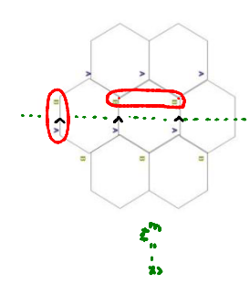
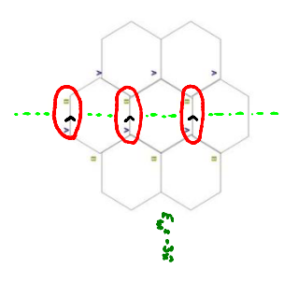
Dimers on non-bipartite lattices
Hardcore dimers on bipartite lattices – U(1) gauge theory. In D=2, confined phase (Polyakov).
Net electric field integer: hence U(1)
Allow for dimers between same
Sublattice – electric field only defined Modulo 2. Hence Z₂ electrodynamics

Slide 4
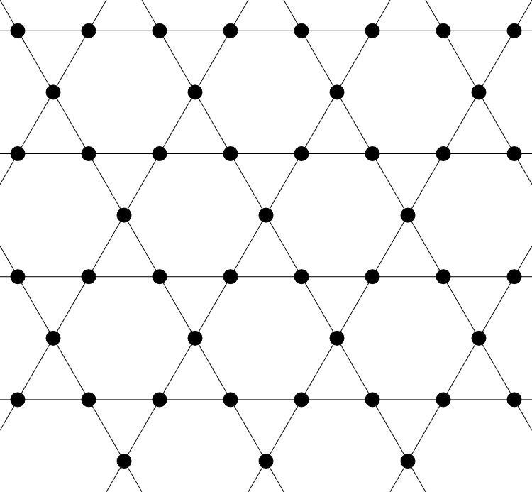

A Microscopic Model on the Kagome Lattice
Ising Limit:
Balents, Fisher and Girvin: arXiv:cond-mat/0110005
Ground state 3 up and 3 down.
Draw dimer through up spins
Dimer model on triangular lattice with 3 dimers per site.
Simpler model – 1 dimer per site of triangular lattice (MoessnerSondhi). Realized here by applying magnetic field to reach 5 down 1 up state (2/3 magnetization plateau). Quantum dynamics comes from XY spin terms.

Slide 5
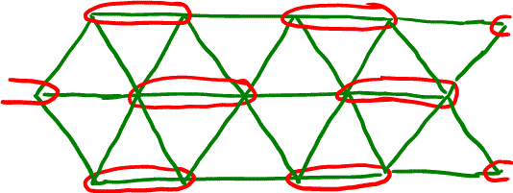
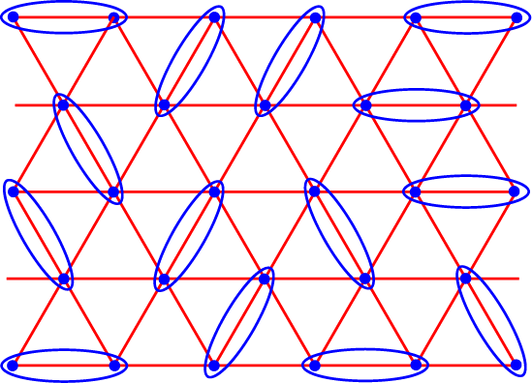
Spin Liquids, Deconfinement and Fractionalization
Solid phase of dimers – magnetic order
Liquid phase of dimers – spin liquid
+ Fluctuations

Slide 6
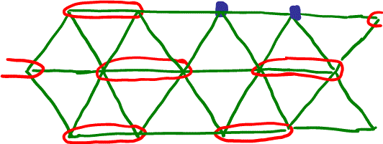
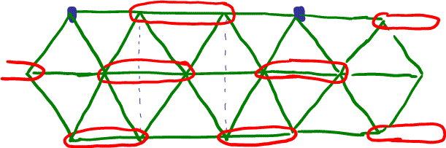
Confinement
Solid phase of dimers – magnetic order
Consider flipping Spin up to Spin down.
  Erase a dimer. Two defective sites. Energy cost =a.Length
Analogous to quark confiement. Here ‘quarks carry Sz=1/2, fractional spin!

Slide 7
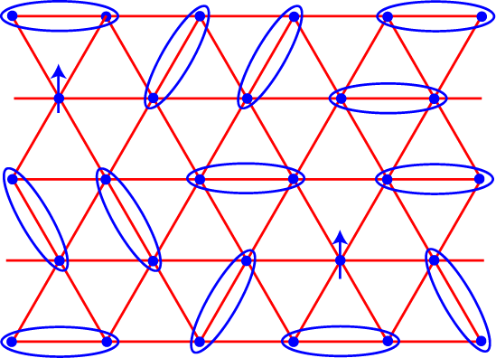
…and Deconfinement
Energy cost for separating S_{z}=1/2 defects finite in spin liquid phase. Deconfinement.
Lowest spin excitations S_{z}=1/2 (neutral excitation with spin ½; fraction of electron’s quantum numbers)
Minimal model: Z₂ lattice gauge theory – will allow us to understand ‘topological order’

Slide 8
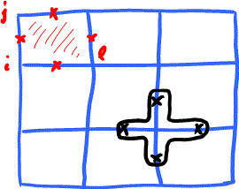

Z₂ lattice gauge theory
Artificial Model: Spin ½ living on the bonds of a square lattice. σ (Pauli matrices)
h=0: Kitaev’s Toric Code (see arXiv:0904.2771)
,Ising electrodynamics (Gauge group Z₂):

Slide 9
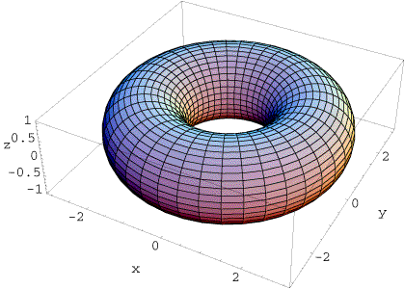
Topological Order
A defining property of the deconfined phase – topological order.
Gapped system. Degeneracy of ground state depends on topology of surface – disc/cylinder/torus. No local operator can distinguish ground states. (Wen)
B=0
B=π
2 fold degeneracy on cylinder
4 fold degeneracy on torus
“Flux” detected only via Aharanov-Bohm effect.
Intrinsic protection of quantum information – topological quantum computing.

Slide 10
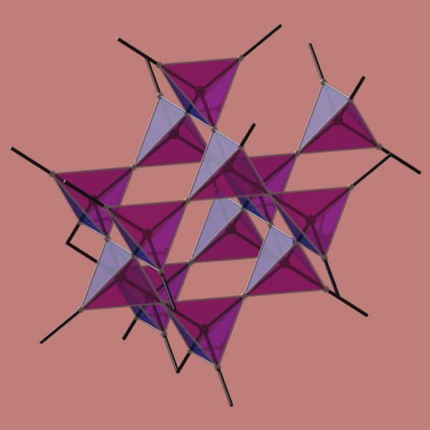
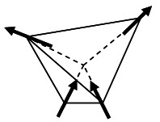
2. Frustration and Dimers in D=3
Spin Ice eg. Ho₂Ti₂O₇
  Magnetic Ho ions on pyrochlore lattice (corner sharing tetrahedra).
  Large spin: ( : Classical Moment)
  Dominant energy scale: Single ions anisotropy – leads to Ising like spins along axis tetrahedron center.
  Ferromagnetic interactions leads to frustration. Dipolar origin (Harris).
  Obey Ice Rules (2 in, 2 out).
  Dimers on dual lattice (bipartite diamond lattice). Maps to U(1) “magneto statics” (no dynamics).

Slide 11
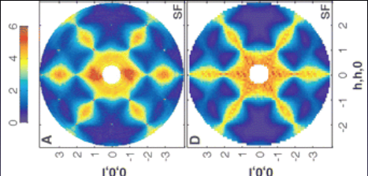
Emergent Magnetostatics
Assume ice rules perfectly obeyed.
Leads to singular points in neutron scattering (pinch points)
T. Fennel et al., arXiv:0907.0954
EXP
THEORY

Slide 12
Spin Ice and Beyond
Defects of perfect ice rule – eg. 3 in 1 out – “magnetic monopoles” (Castelnovo-Moessner-Sondhi)
  Experimental signatures observed in neutron scattering, spin relaxation etc.
Quantum versions of spin ice? U(1) quantum spin liquid in D=3. (theoretical proposals – Hermele et al., 2004; A. Banerjee et al.2008).

Slide 13
Novel Quantum Phase Transitions in Frustrated Magnets
S=1/2 on a square lattice (D=2).
  Eg. undoped cuprates La₂CuO₄
  Add frustration
Breaks Lattice Symmetry →
Order-Parameter

Slide 14
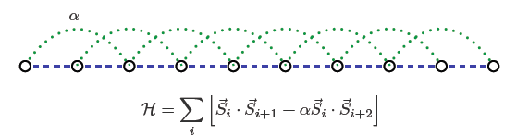
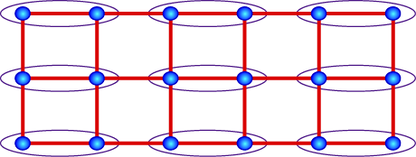
Analogous to 1D Chain
J1-J2 model on S=1/2 chain
Phase Diagram:
Luttinger liquid
Dimerized (Z₂ order parameter)
0.2

Slide 15
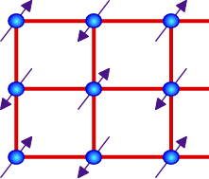
Phase Diagram…
?
Neel
VBS

Slide 16
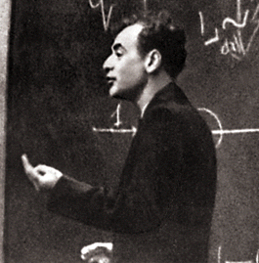
Landau’s Rules
Two unrelated orders – Neel and VBS
No direct transition that is continuous
Not possible! Needs special fine tuning
Generic Possibilities in Landau Theory
First Order
Coexistence

Slide 17
Not True for Quantum Transitions!
Continuous transition directly between Neel and VBS is a generic possibility
  Theory of the critical point – NOT order parameter fluctuations (Landau-Ginzburg-Wilson) new “spin liquid” variables:
    emergent `photons’
    fractionalized excitations
BUT phases, Neel and VBS, are conventional.
Senthil, AV, Balents, Sachdev, Fisher (2003); Motrunich and AV (2003)

Slide 18
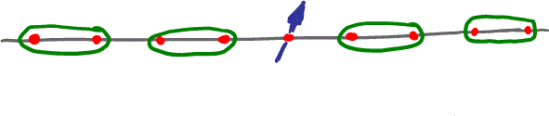
Intuition from1D Chain
J1-J2 model on S=1/2 chain
Luttinger liquid
Dimerized (Z₂ order parameter)
0.2
Critical point XY like (despite Ising order parameter)
Defects (domain walls) of Ising order carry spin.
Proliferate defects – destroys Valence bond order, and induced ‘Neel’ (not true long range order).

Slide 19
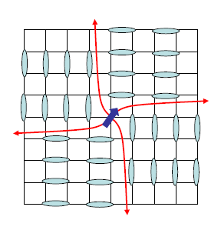
Mechanism of Non-Landau Transition
Defects that disorder the phase carry nontrivial quantum numbers.
Vortices in valence bond solid carry order carry spin ½ at their centers (topological property). Proliferate vortices – destroy VBS order and establish Neel order. Quantum effect.
Analogies to experimentally observed transitions in Heavy Fermion systems.
Spin ½
Levin and Senthil

Slide 20
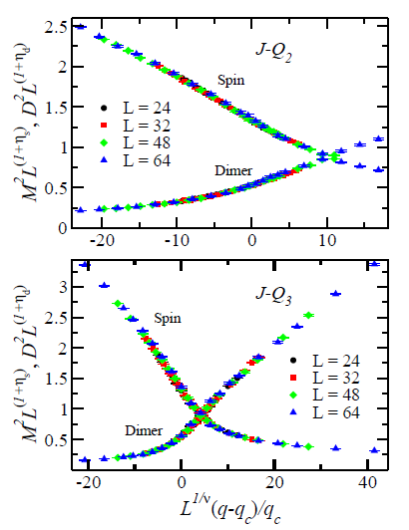
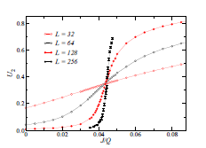
Numerical Experiments
Quantum Monte Carlo on J-Q₂ (4 spin term) model (Sandvik). Continuous transition with some features of deconfined critical point (large eta, z=1) seen. Exponents agree in 2 models
J. Lou, A. W. Sandvik, N. Kawashima: arXiv:0908.0740
Recently proposed – log corrections in some quantities.
Sandvik, arXiv:1001.4296. Needs more work!
Other Models:
Harada, Kawashima, Troyer arXiv:cond-mat/0608446

Slide 21
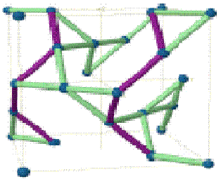
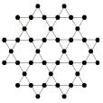
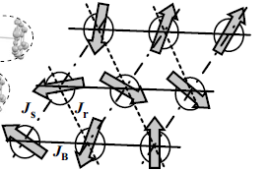
Experimental Candidates for Spin Liquids
 | T. Itou, et al. PRB 2007) 4. EtMe₃Sb[Pd(dmit)₂]₂ a spin ½ triangular lattice quantum magnet, with J=220Kelvin But no order down to T=0.02Kelvin (Near Mott Transition)
Okamoto et al. 2007
Shimizu et al. 2004
κ-(ET)₂Cu₂(CN)₆ a spin ½ triangular lattice quantum magnet, with J=250Kelvin
But no order down to T=0.032Kelvin
Na₄Ir₃O₈ a spin ½ ; 3D hyperkagome,
J=600K, no order to T=2K
Helton et al. 2006
ZnCu₃(OH)₆Cl₂ (herbertsmithite) a spin ½ Kagome magnet, J=200K
  But no ordering down to T=0.05K
No Gap! Critical Spin Liquids. Suggests fermionic spin excitations and U(1) gauge fields

Slide 22
Geometric Frustration
Ingredients for novel physics:
Constrained space+ Quantum mechanics
  Frustrated magnetism (low energy manifold)
    Add quantum mechanics
  Quantum Hall Effect (constraint: lowest Landau level)
    Strong magnetic field: electrons confined to degenerate ground states inside the lowest Landau level.
  Doped Mott insulators (0, 1 electron per site)
    Hole doping: either 0 or 1 electron per site (2 electrons very expensive: U)
    High temperature superconductivity

Slide 23
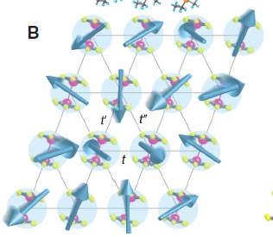
Conclusions
Quantum Theory of Solids has been dominated by Landau Paradigm. (Order parameters & spontaneous symmetry breaking).
  “More is Different” - P. W. Anderson
In the future; Spin liquids, …?
“Quantum is Different??”

